Slide 1
SHARE 2012 Ground Truth Summary for AFRL Array
Jason Kaufman
Space Computer Corporation
October 1, 2012

Slide 2
Overview
Target Information
Target Array Configurations
GPS Information / Sample KML View
Ground Photos
Team Information

Slide 3
Target Shapes
Shape | Edge/Radius | Area | Max GSD for Full Pixel
Circle | 3.43ft / 1.045m | 36.89ft² / 3.427m² | 2.42ft / 0.738m
Equilateral Triangle | 9.23ft / 2.813m | 36.89ft² / 3.427m² | 2.0ft / 0.610m
Square | 6.07ft / 1.850m | 36.89ft² / 3.427m² | 3.04ft / 0.927m
circle
equilateral triangle
square
equilateral triangle (15.5in / 0.394m)
rectangle (21.1875in by 15.5in) (0.538m by 0.394m)
circle (7.75in / 0.197m)
4in / 0.102m spacing
square base (55.375in / 1.407m)
asymmetric shape (same surface area as other shapes)

Slide 4
Target Shapes - Errata
Blue tarp #52 was mistakenly configured as a mirror image of the asymmetric shape previously described. Dimensions of the individual components comprising this target are exactly the same.
Shape of asymmetric targets 50,51,55-57
Shape of asymmetric target 52

Slide 5
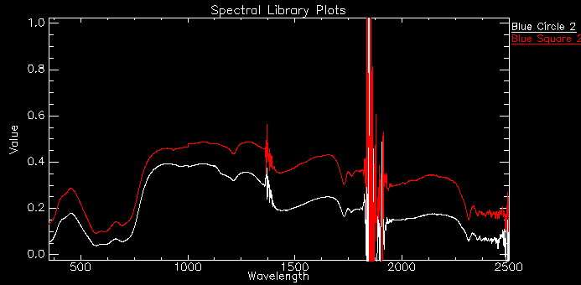
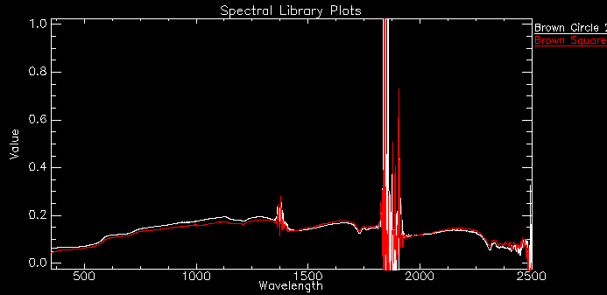
Target Spectral Information
Blue Vinyl Tarps
Circle is single-ply tarp, note reduced spectral response due to slight bleed through of grass
Square and other shapes are less susceptible due to multi-ply thickness
Brown Vinyl Tarps - Material is fairly opaque, very little difference between single and multi-ply thicknesses

Slide 6
Target Serial Numbers
Shape | Color | Serial Range
Triangle | Blue | 30-32
Triangle | Brown | 35-37
Square | Blue | 40-42
Square | Brown | 45-47
Asymmetric | Blue | 50-52
Asymmetric | Brown | 55-57
Circle | Blue | 60-62
Circle | Brown | 65-75

Slide 7
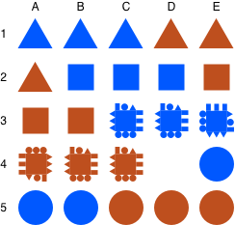
Target Array Configurations
Date: September 17, 2012
“Dry Run”
WorldView-2 collection
Small shapes on edges of targets at 3C through 4C were not secured (see photos)
30
31
32
35
36
37
40
41
42
45
46
47
50
51
52
55
56
57
60
61
62
65
66
67

Slide 8
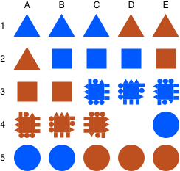
Target Array Configurations
Date: September 20, 2012
Morning/initial configuration
Differences from “dry run” layout limited to rotation of targets at 3D/3E and 4A/4B/4C, respectively
All small shapes on edges of targets at 3C through 4C properly secured
30
31
32
35
36
37
40
41
42
45
46
47
50
51
52
55
56
57
60
61
62
65
66
67

Slide 9
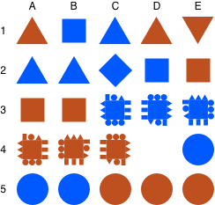
Target Array Configurations
Date: September 20, 2012
Transitional configuration at approximately 12:35 PM, as seen by WorldView-2
Differences from AM layout:
1A and 2A swapped
1B and 2B swapped
1E 180-degree rotation
2C, 3D, 3E 90-degree rotation
37
40
32
35
36
30
31
41
42
45
46
47
50
51
52
55
56
57
60
61
62
65
66
67

Slide 10
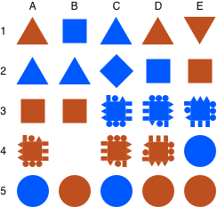
Target Array Configurations
Date: September 20, 2012
Afternoon/final configuration
Differences from “transitional” layout:
Move 4C to 4D and rotate 90 degrees
Move 4B to 4C and rotate 90 degrees
Swap 5B and 5C
37
40
32
35
36
30
31
41
42
45
46
47
50
51
52
55
56
57
60
61
65
62
66
67

Slide 11
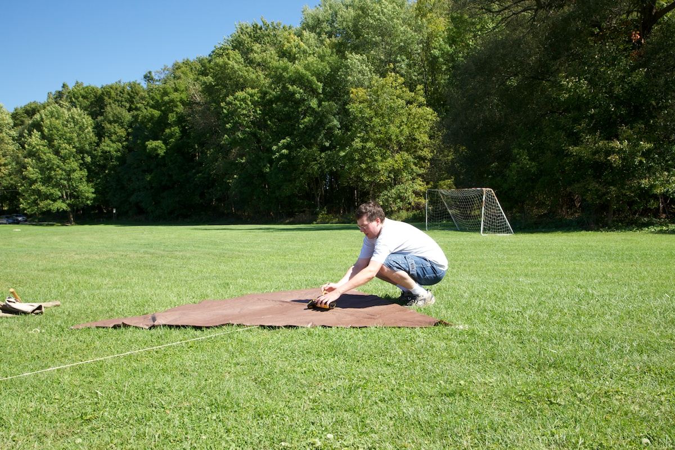
GPS Information
Trimble differential GPS receiver
Receiver placed at each target’s center
10 samples collected on each target
Measurements corrected via data from NYPF
Most corrected target locations accurate to within 5-15cm

Slide 12
Sample KML View
20120917 dry run configuration

Slide 13
Ground Photos
Photos taken of array post-setup on Sep. 17, Sep. 20 AM, and Sep. 20 PM
Looking along each row
Looking along each column
Close-ups of each asymmetric target to verify heading
Miscellaneous site photos

Slide 14
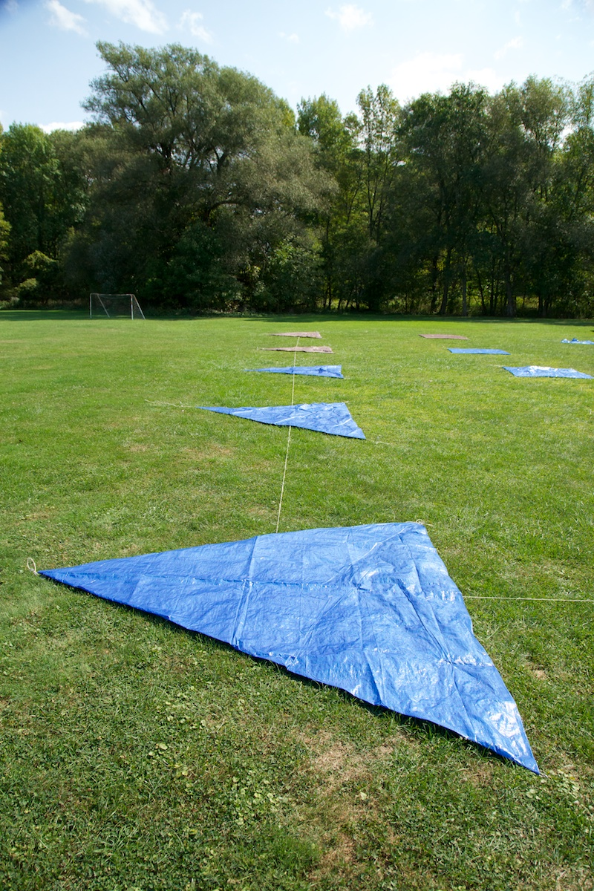
Ground Photos: 2012-09-17
30
31
32
35
36
37
40
41
42
45
46
47
50
51
52
55
56
57
60
61
62
65
66
67
Name: _MG_9071.jpg
Description: Row 1
Date: 2012-09-17

Slide 15
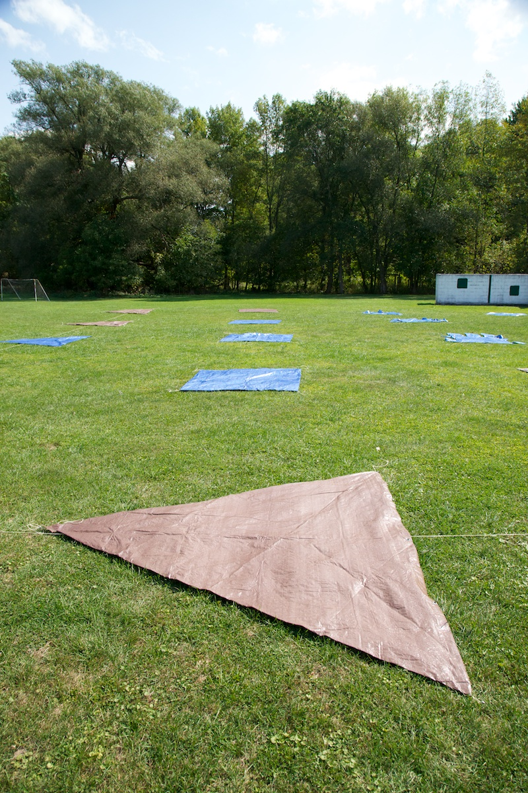
Ground Photos: 2012-09-17
30
31
32
35
36
37
40
41
42
45
46
47
50
51
52
55
56
57
60
61
62
65
66
67
Name: _MG_9073.jpg
Description: Row 2
Date: 2012-09-17

Slide 16
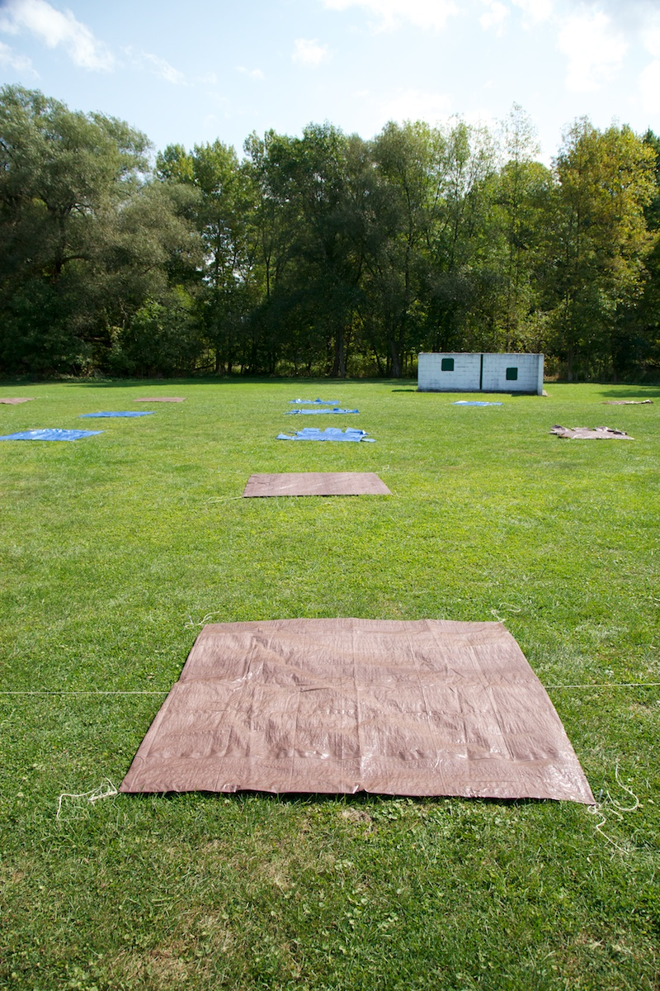
Ground Photos: 2012-09-17
30
31
32
35
36
37
40
41
42
45
46
47
50
51
52
55
56
57
60
61
62
65
66
67
Name: _MG_9074.jpg
Description: Row 3
Date: 2012-09-17

Slide 17
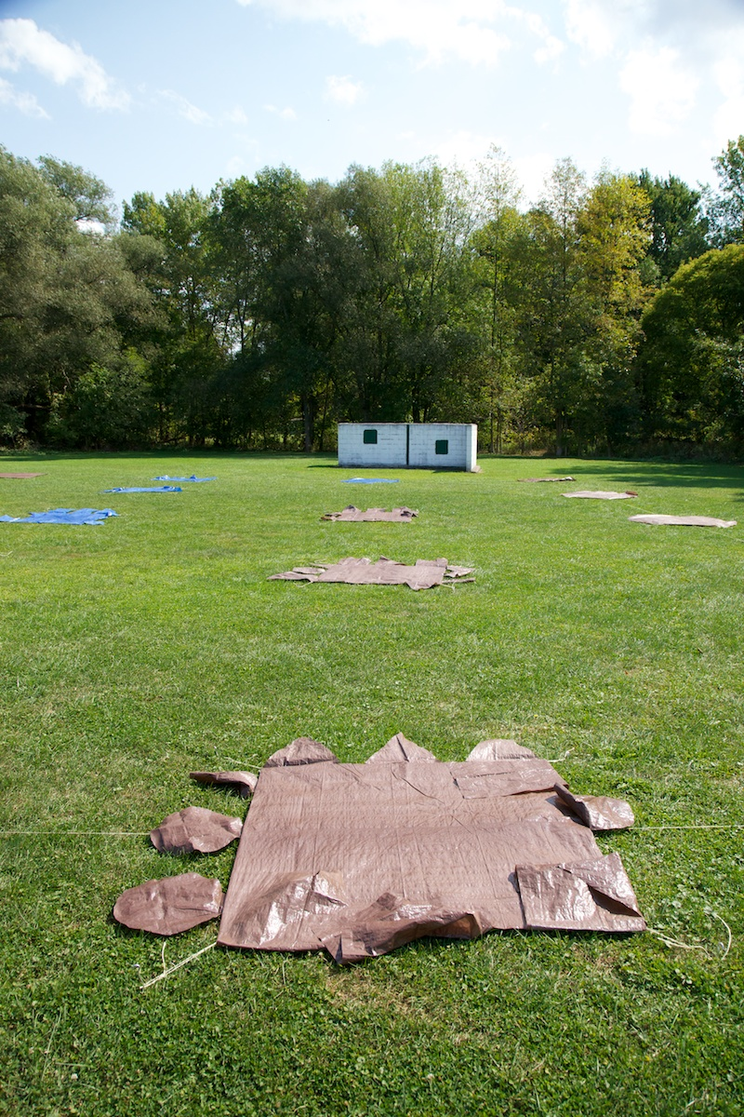
Ground Photos: 2012-09-17
30
31
32
35
36
37
40
41
42
45
46
47
50
51
52
55
56
57
60
61
62
65
66
67
Name: _MG_9075.jpg
Description: Row 4
Date: 2012-09-17

Slide 18
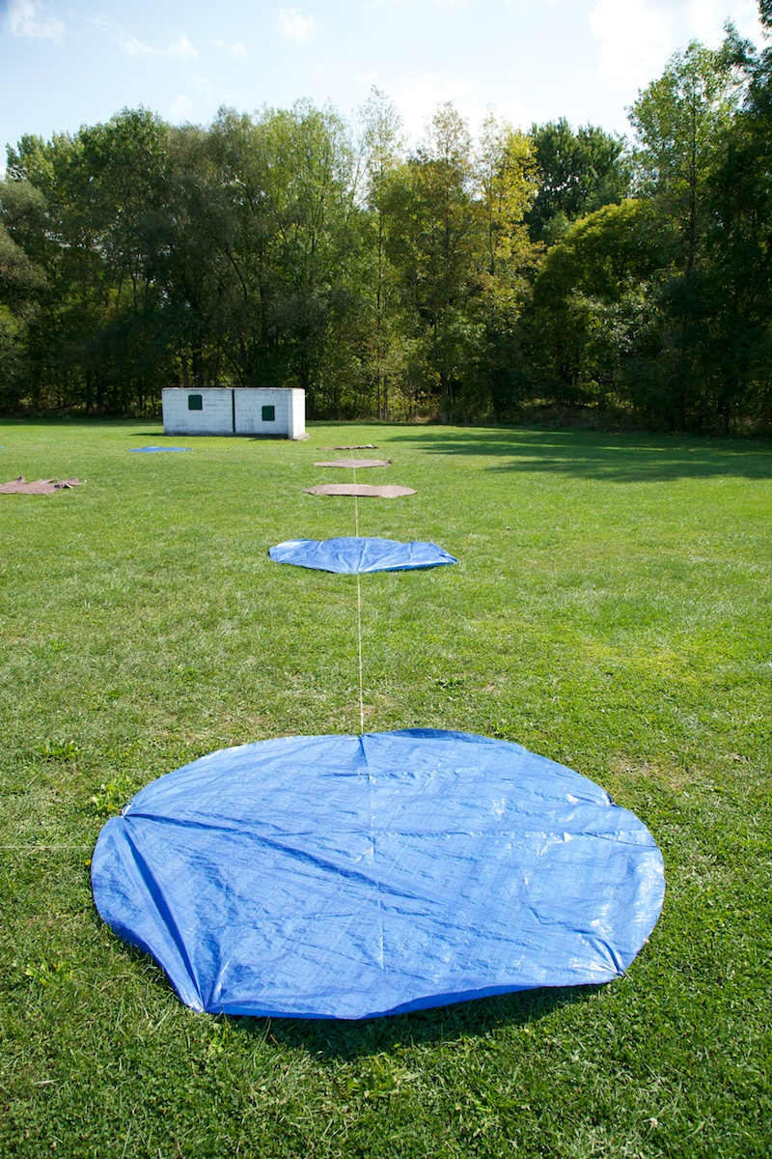
Ground Photos: 2012-09-17
30
31
32
35
36
37
40
41
42
45
46
47
50
51
52
55
56
57
60
61
62
65
66
67
Name: _MG_9076.jpg
Description: Row 5
Date: 2012-09-17

Slide 19
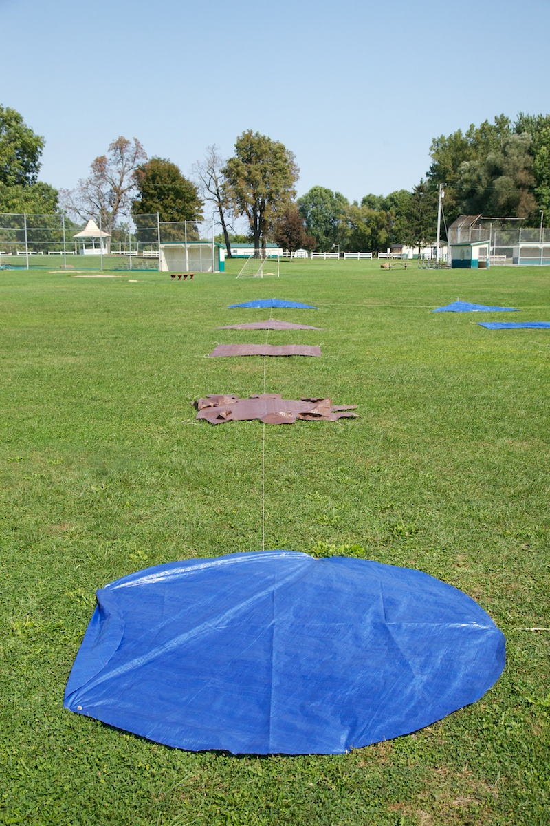
Ground Photos: 2012-09-17
30
31
32
35
36
37
40
41
42
45
46
47
50
51
52
55
56
57
60
61
62
65
66
67
Name: _MG_9059.jpg
Description: Column A
Date: 2012-09-17

Slide 20
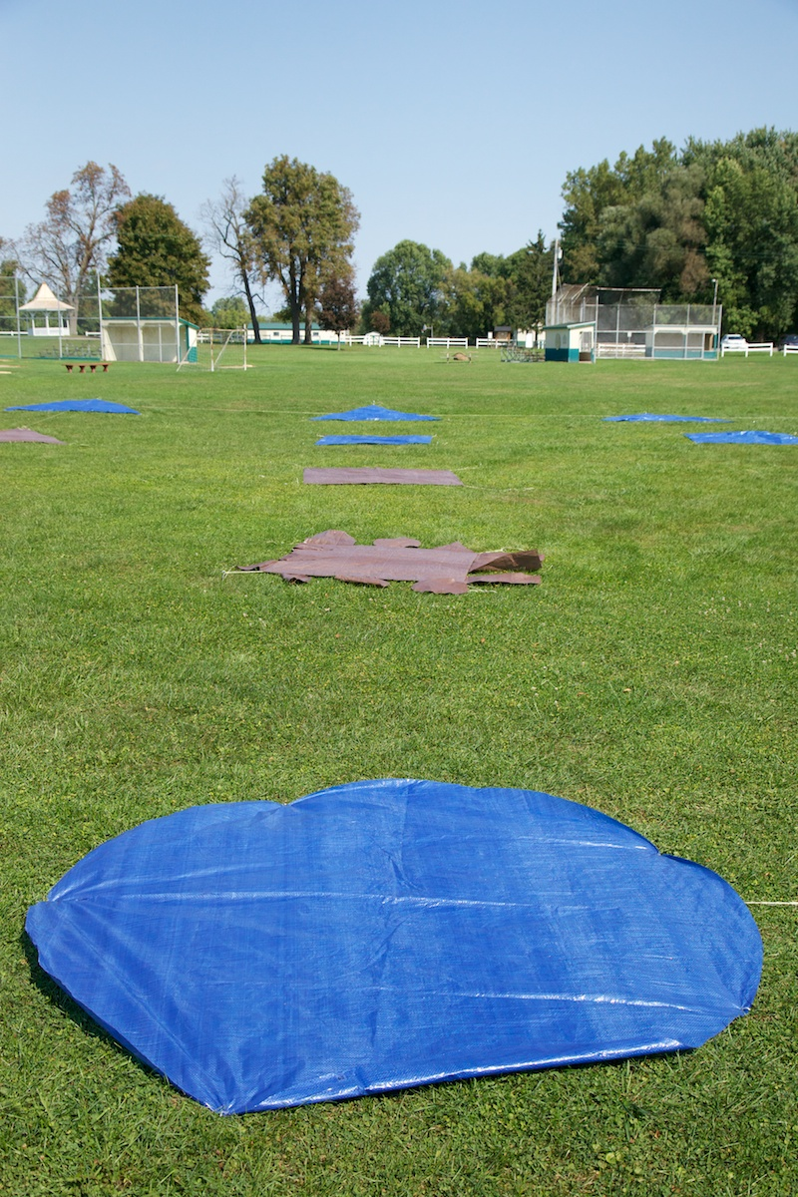
Ground Photos: 2012-09-17
30
31
32
35
36
37
40
41
42
45
46
47
50
51
52
55
56
57
60
61
62
65
66
67
Name: _MG_9060.jpg
Description: Column B
Date: 2012-09-17

Slide 21
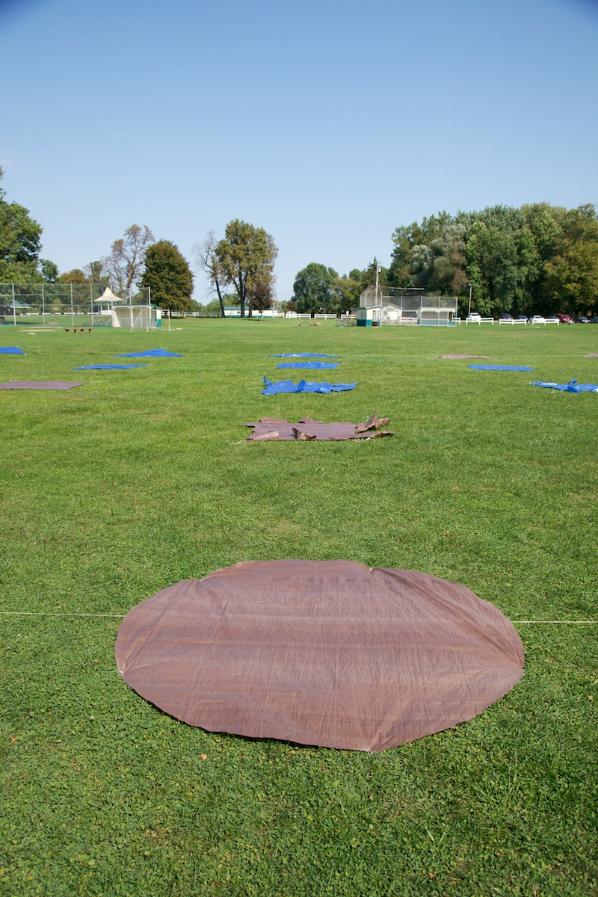
Ground Photos: 2012-09-17
30
31
32
35
36
37
40
41
42
45
46
47
50
51
52
55
56
57
60
61
62
65
66
67
Name: _MG_9062.jpg
Description: Column C
Date: 2012-09-17

Slide 22
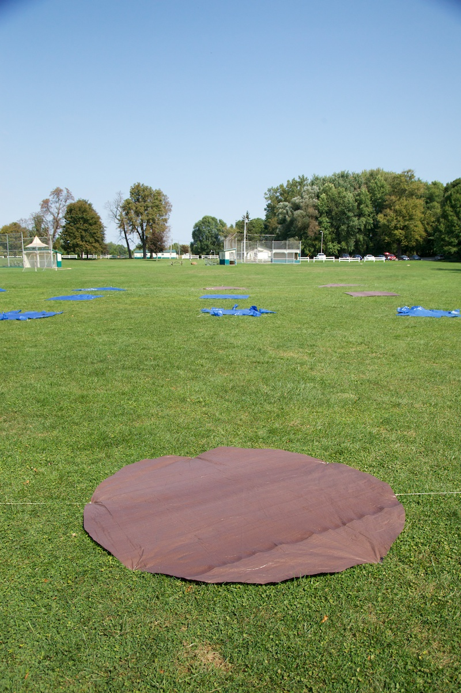
Ground Photos: 2012-09-17
30
31
32
35
36
37
40
41
42
45
46
47
50
51
52
55
56
57
60
61
62
65
66
67
Name: _MG_9063.jpg
Description: Column D
Date: 2012-09-17

Slide 23
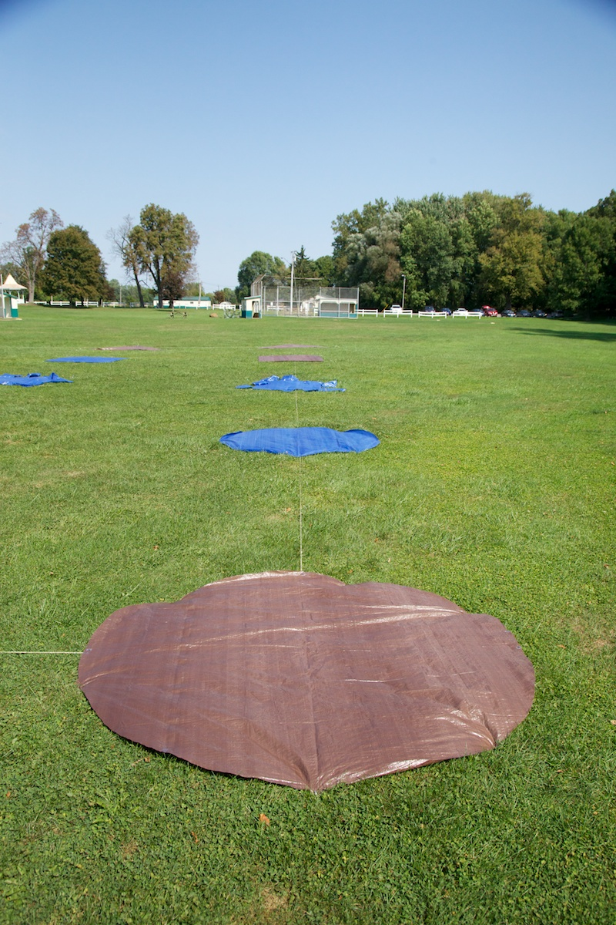
Ground Photos: 2012-09-17
30
31
32
35
36
37
40
41
42
45
46
47
50
51
52
55
56
57
60
61
62
65
66
67
Name: _MG_9064.jpg
Description: Column E
Date: 2012-09-17

Slide 24
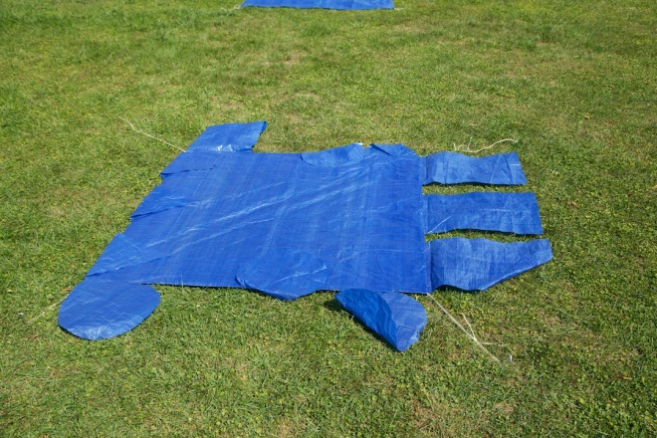
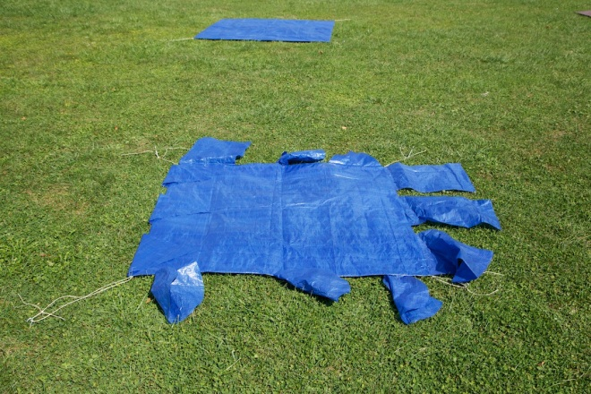
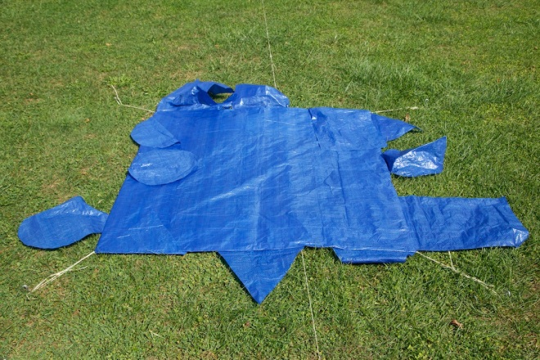
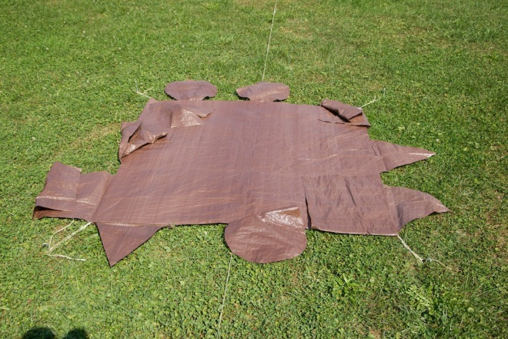
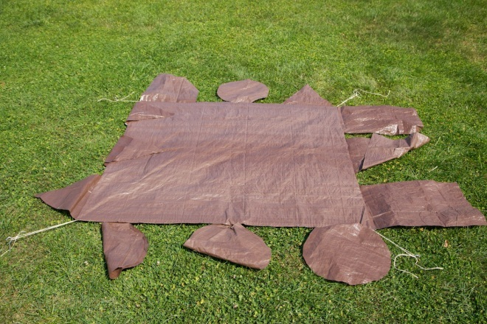
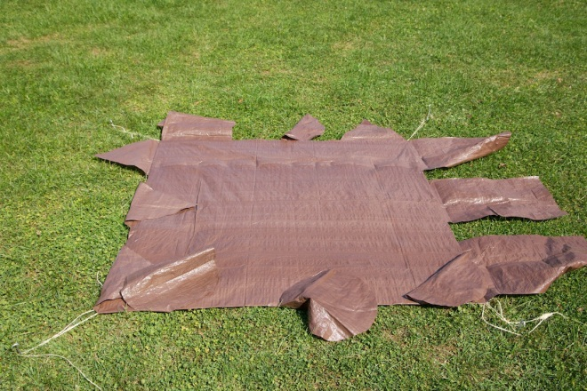
Dry Run Asymmetric Targets (Looking North)
50 at 3C (_MG_9053.jpg)
51 at 3D
(_MG_9054.jpg)
52 at 3E
(_MG_9055.jpg)
55 at 4A
(_MG_9056.jpg)
56 at 4B
(_MG_9057.jpg)
57 at 4C
(_MG_9058.jpg)

Slide 25
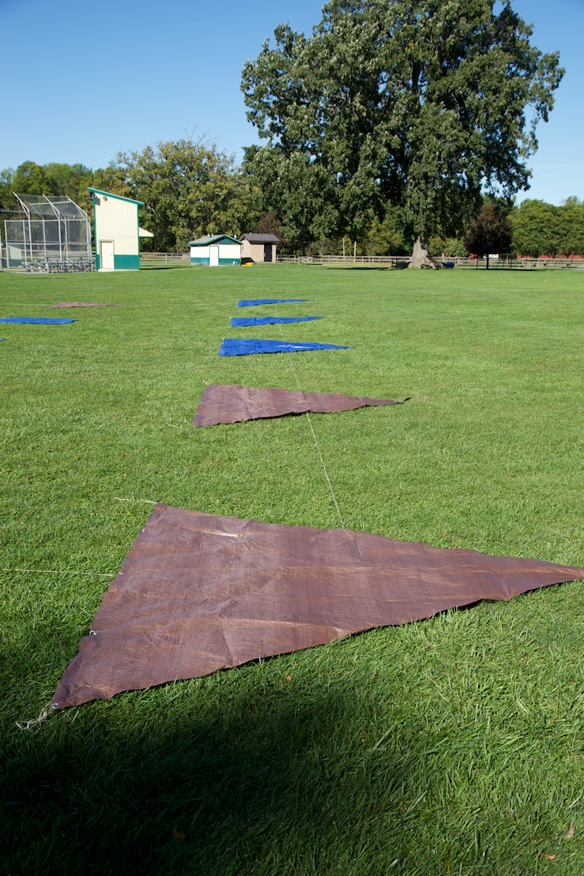
Ground Photos: 2012-09-20 AM
30
31
32
35
36
37
40
41
42
45
46
47
50
51
52
55
56
57
60
61
62
65
66
67
Name: _MG_9133.jpg
Description: Row 1
Date: 2012-09-20 AM

Slide 26
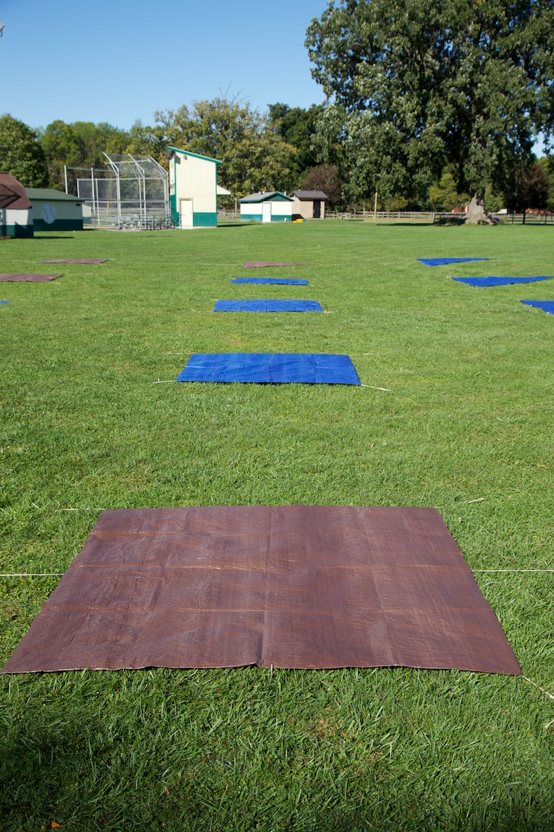
Ground Photos: 2012-09-20 AM
30
31
32
35
36
37
40
41
42
45
46
47
50
51
52
55
56
57
60
61
62
65
66
67
Name: _MG_9134.jpg
Description: Row 2
Date: 2012-09-20 AM

Slide 27
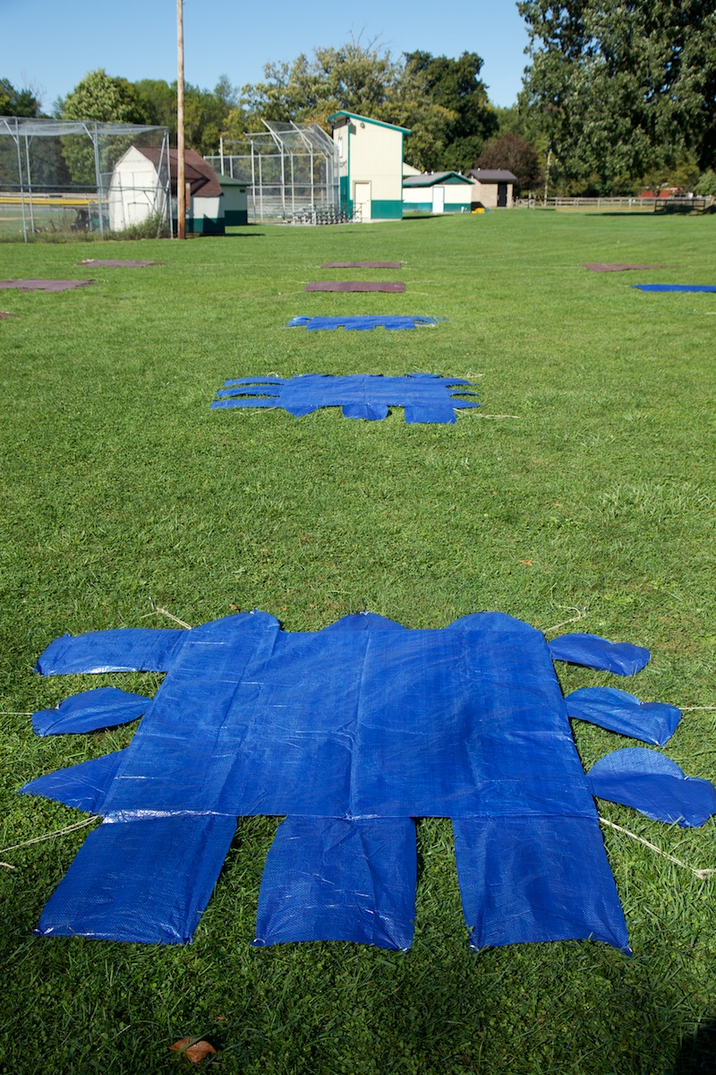
Ground Photos: 2012-09-20 AM
30
31
32
35
36
37
40
41
42
45
46
47
50
51
52
55
56
57
60
61
62
65
66
67
Name: _MG_9135.jpg
Description: Row 3
Date: 2012-09-20 AM

Slide 28
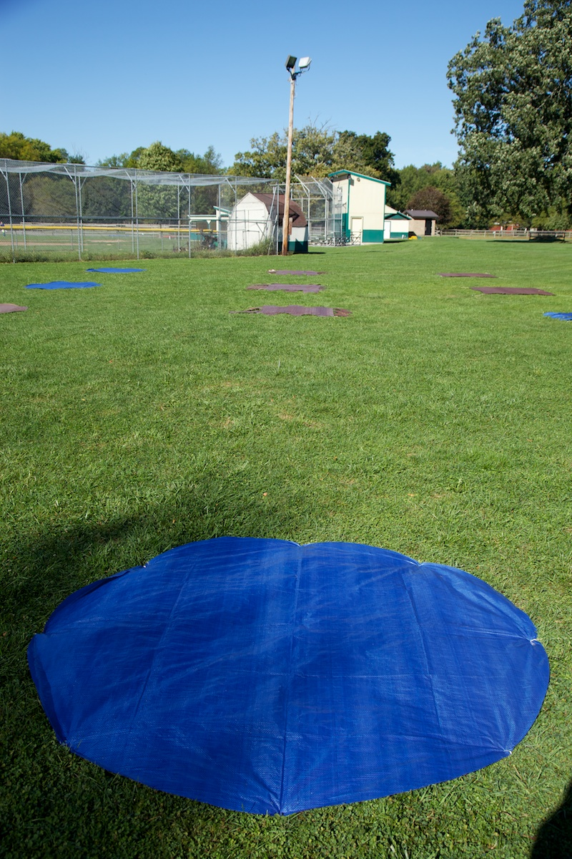
Ground Photos: 2012-09-20 AM
30
31
32
35
36
37
40
41
42
45
46
47
50
51
52
55
56
57
60
61
62
65
66
67
Name: _MG_9135.jpg
Description: Row 4
Date: 2012-09-20 AM

Slide 29
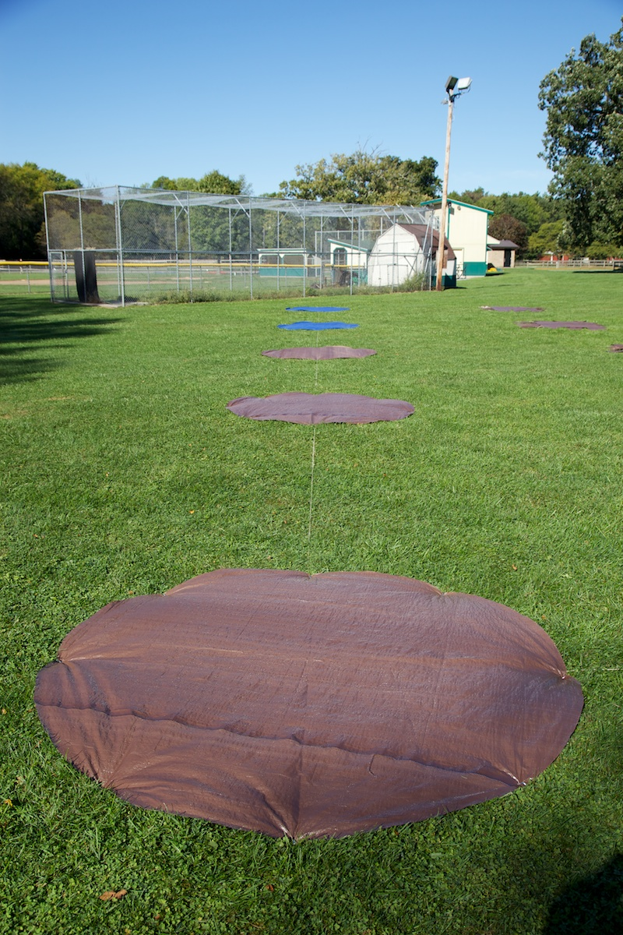
Ground Photos: 2012-09-20 AM
30
31
32
35
36
37
40
41
42
45
46
47
50
51
52
55
56
57
60
61
62
65
66
67
Name: _MG_9135.jpg
Description: Row 5
Date: 2012-09-20 AM

Slide 30
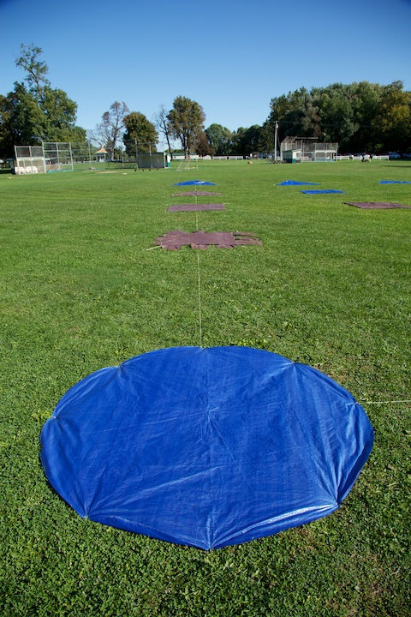
Ground Photos: 2012-09-20 AM
30
31
32
35
36
37
40
41
42
45
46
47
50
51
52
55
56
57
60
61
62
65
66
67
Name: _MG_9138.jpg
Description: Column A
Date: 2012-09-20 AM

Slide 31
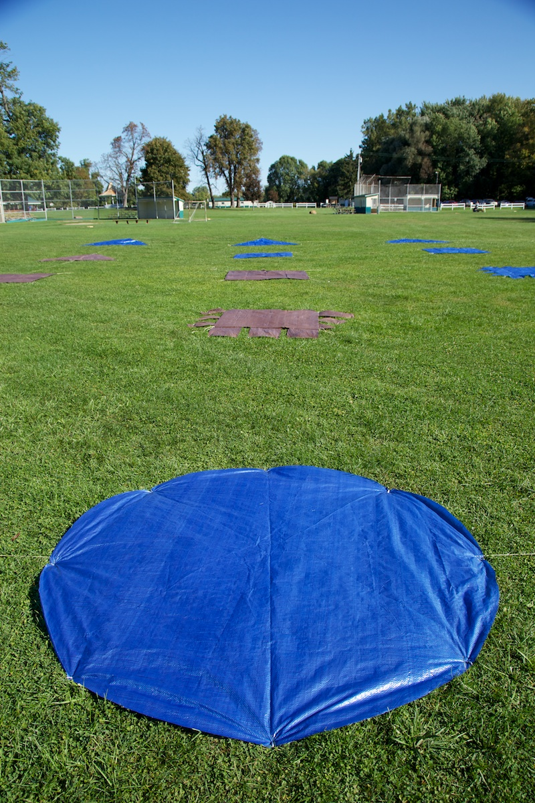
Ground Photos: 2012-09-20 AM
30
31
32
35
36
37
40
41
42
45
46
47
50
51
52
55
56
57
60
61
62
65
66
67
Name: _MG_9139.jpg
Description: Column B
Date: 2012-09-20 AM

Slide 32
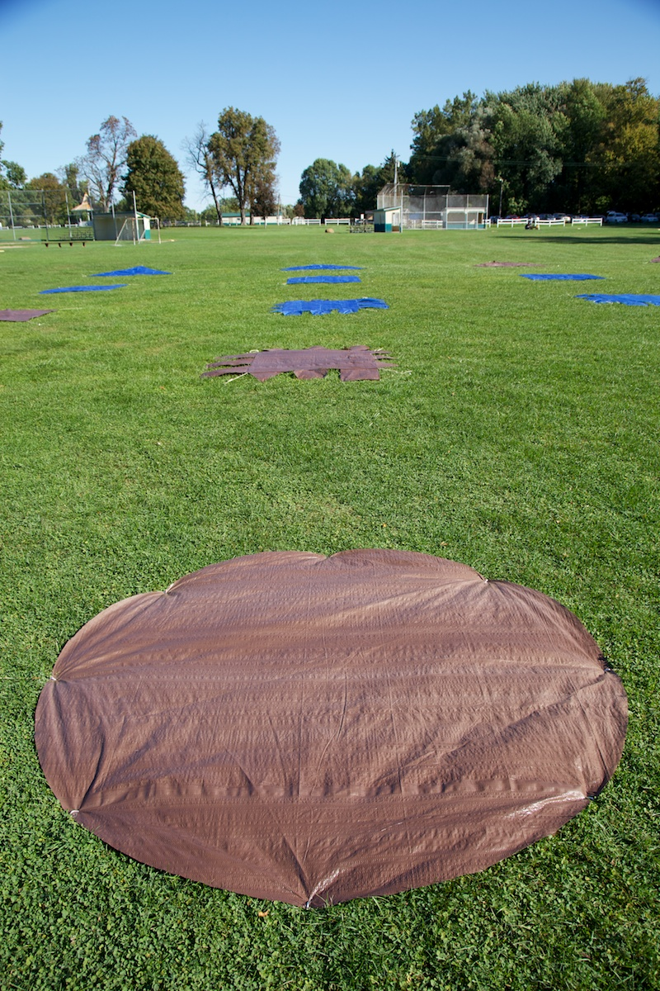
Ground Photos: 2012-09-20 AM
30
31
32
35
36
37
40
41
42
45
46
47
50
51
52
55
56
57
60
61
62
65
66
67
Name: _MG_9140.jpg
Description: Column C
Date: 2012-09-20 AM

Slide 33
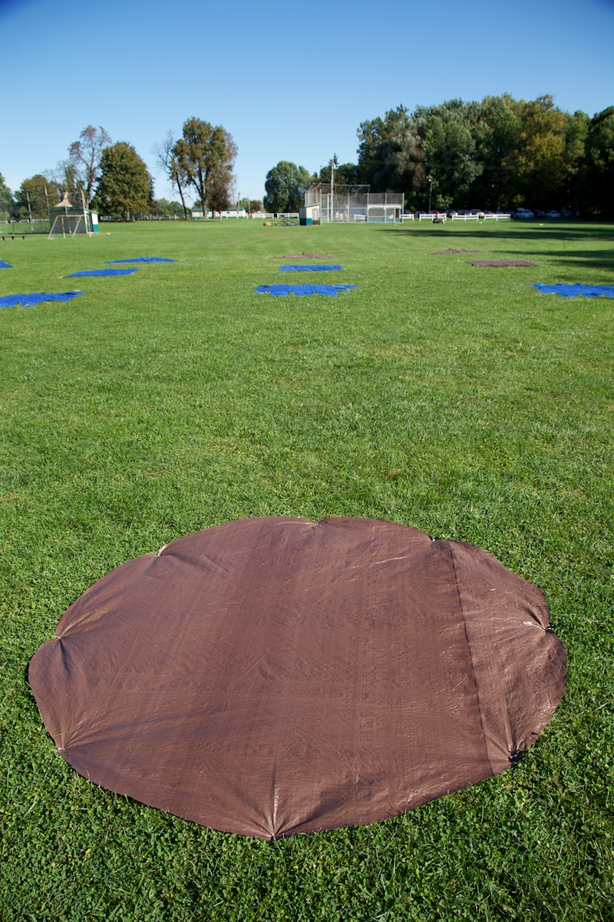
Ground Photos: 2012-09-20 AM
30
31
32
35
36
37
40
41
42
45
46
47
50
51
52
55
56
57
60
61
62
65
66
67
Name: _MG_9141.jpg
Description: Column D
Date: 2012-09-20 AM

Slide 34
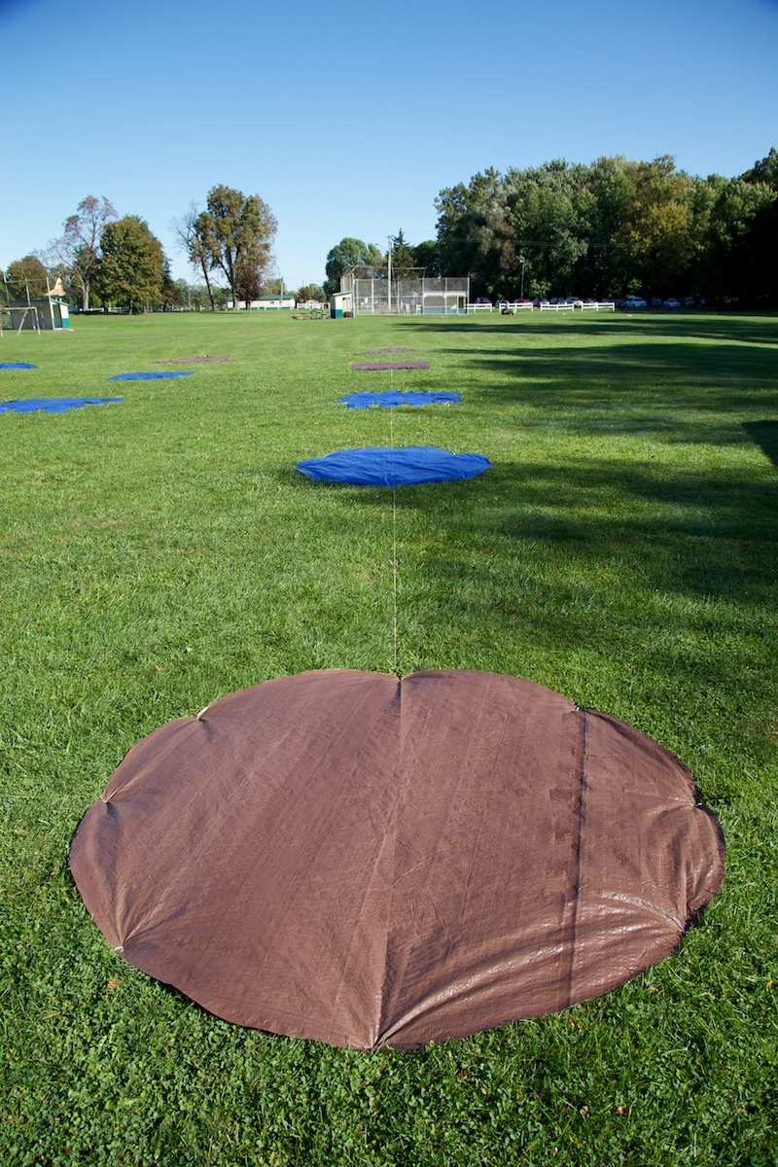
Ground Photos: 2012-09-20 AM
30
31
32
35
36
37
40
41
42
45
46
47
50
51
52
55
56
57
60
61
62
65
66
67
Name: _MG_9142.jpg
Description: Column E
Date: 2012-09-20 AM

Slide 35
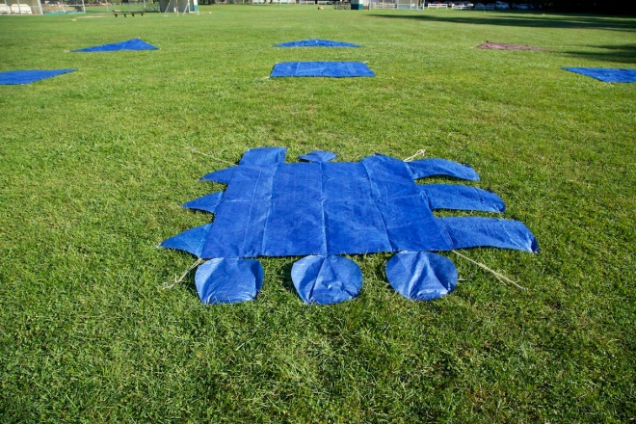
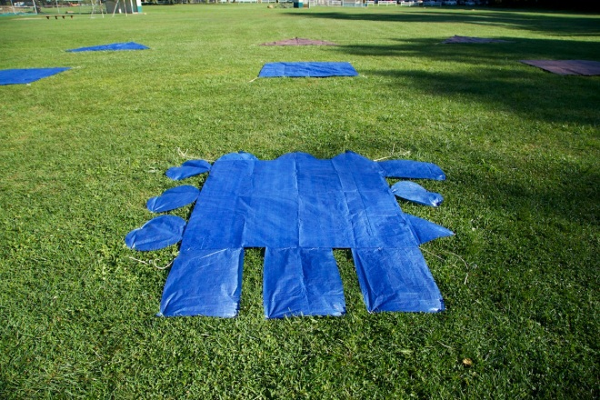
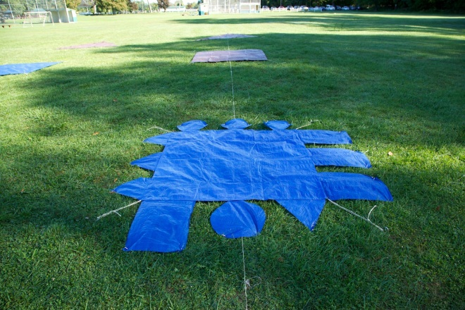
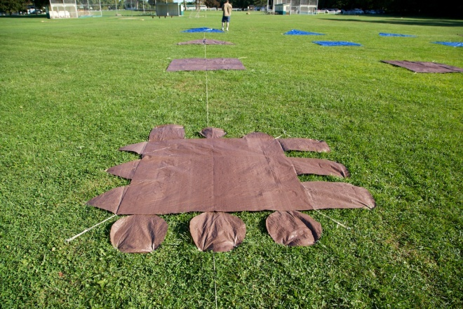
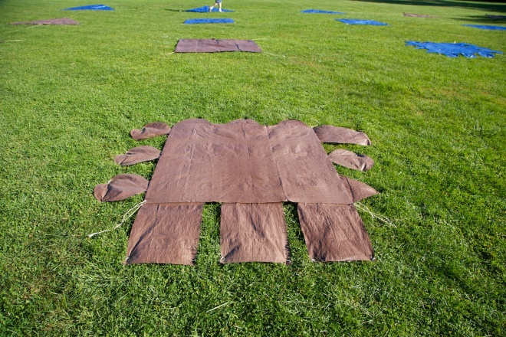
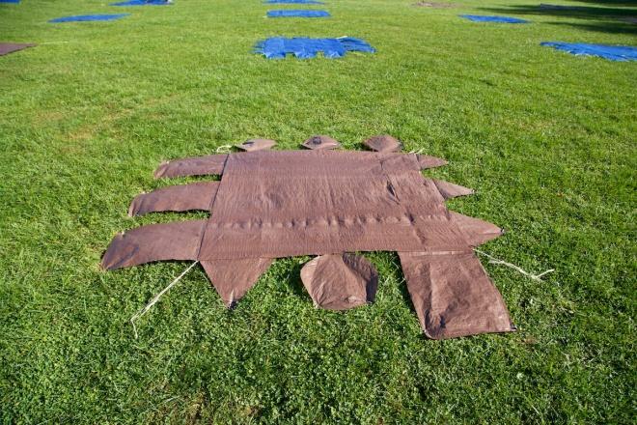
20120920 AM Asymmetric Targets (Looking North)
50 at 3C (_MG_9101.jpg)
51 at 3D
(_MG_9103.jpg)
52 at 3E
(_MG_9105.jpg)
55 at 4A
(_MG_9108.jpg)
56 at 4B
(_MG_9110.jpg)
57 at 4C
(_MG_9112.jpg)

Slide 36
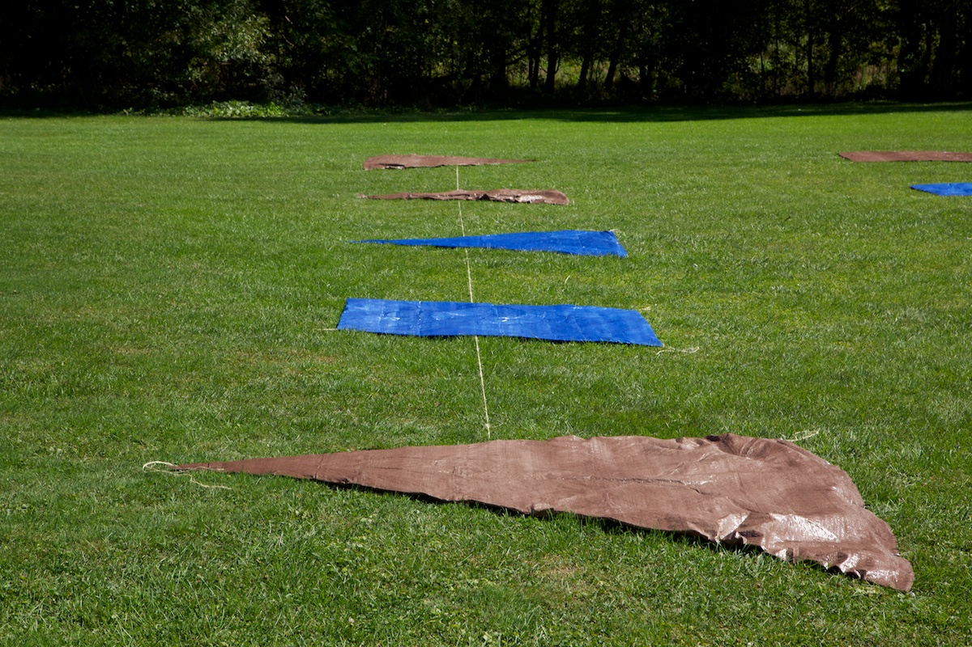
Ground Photos: 2012-09-20 PM
37
40
32
35
36
30
31
41
42
45
46
47
50
51
52
55
56
57
60
61
65
62
66
67
Name: _MG_9190.jpg
Description: Row 1
Date: 2012-09-20 PM

Slide 37
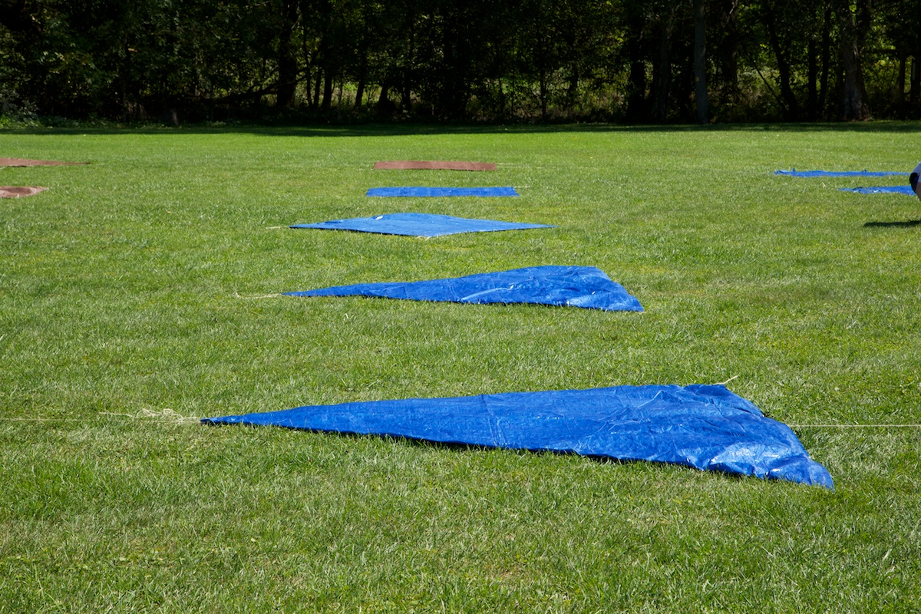
Ground Photos: 2012-09-20 PM
37
40
32
35
36
30
31
41
42
45
46
47
50
51
52
55
56
57
60
61
65
62
66
67
Name: _MG_9192.jpg
Description: Row 2
Date: 2012-09-20 PM

Slide 38
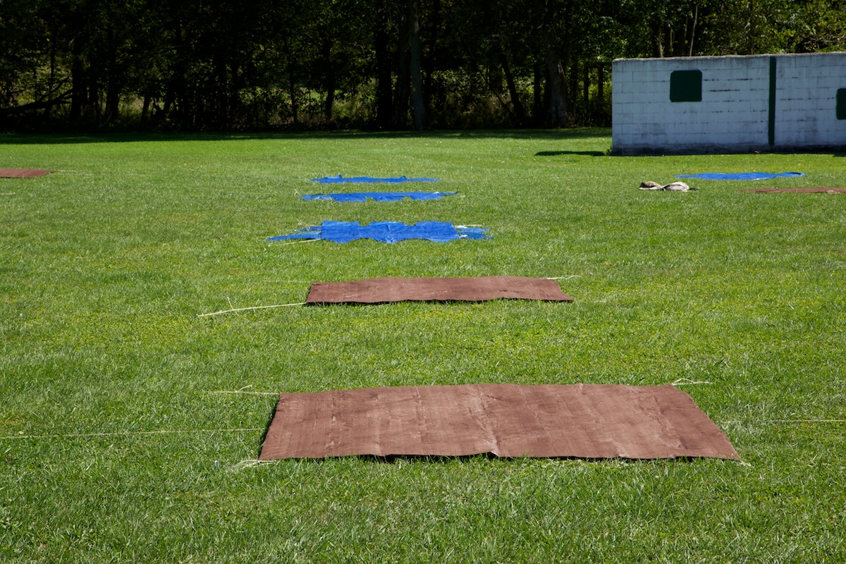
Ground Photos: 2012-09-20 PM
37
40
32
35
36
30
31
41
42
45
46
47
50
51
52
55
56
57
60
61
65
62
66
67
Name: _MG_9195.jpg
Description: Row 3 (jacket on ground in upper right was removed prior to data collection)
Date: 2012-09-20 PM

Slide 39
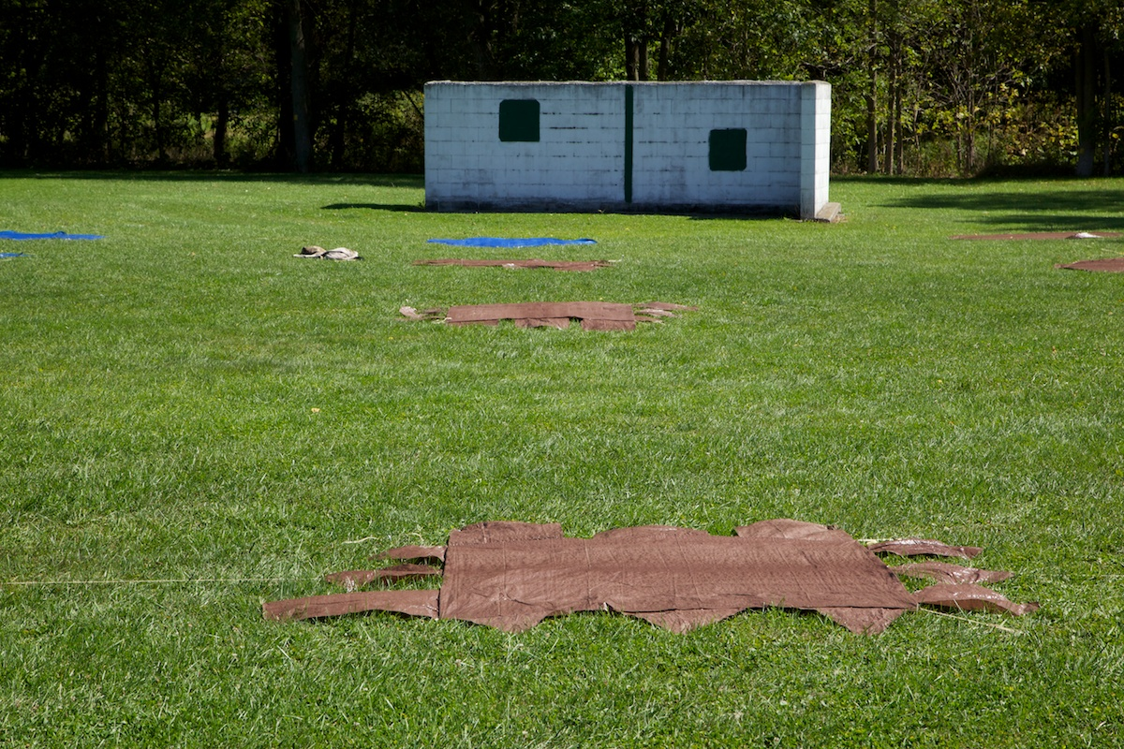
Ground Photos: 2012-09-20 PM
37
40
32
35
36
30
31
41
42
45
46
47
50
51
52
55
56
57
60
61
65
62
66
67
Name: _MG_9196.jpg
Description: Row 4 (jacket on ground in upper left was removed prior to data collection)
Date: 2012-09-20 PM

Slide 40
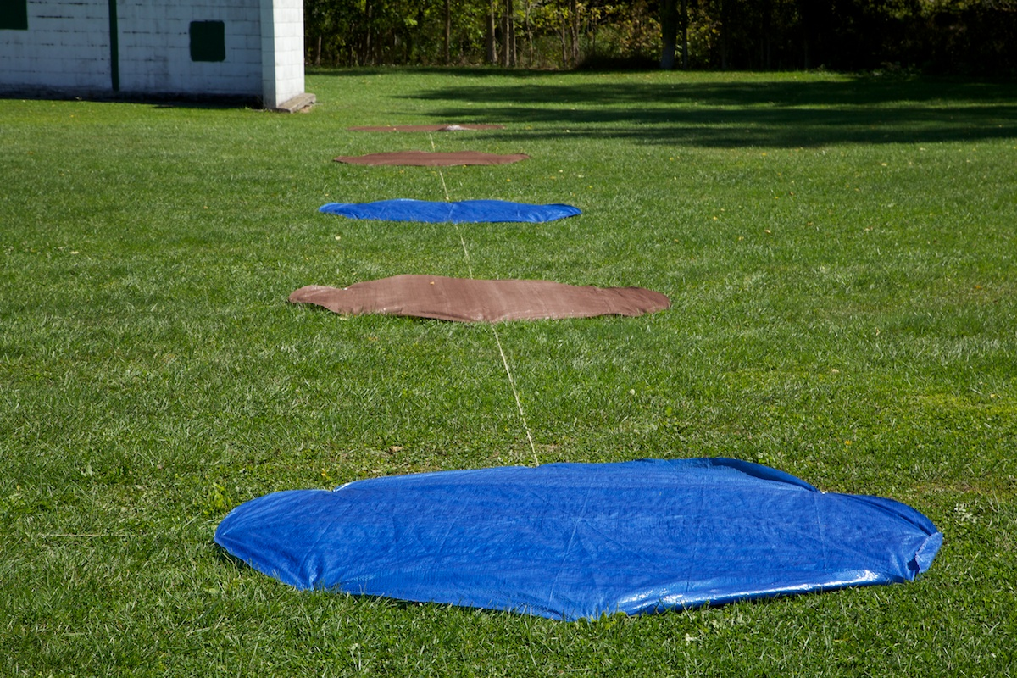
Ground Photos: 2012-09-20 PM
37
40
32
35
36
30
31
41
42
45
46
47
50
51
52
55
56
57
60
61
65
62
66
67
Name: _MG_9199.jpg
Description: Row 5
Date: 2012-09-20 PM

Slide 41
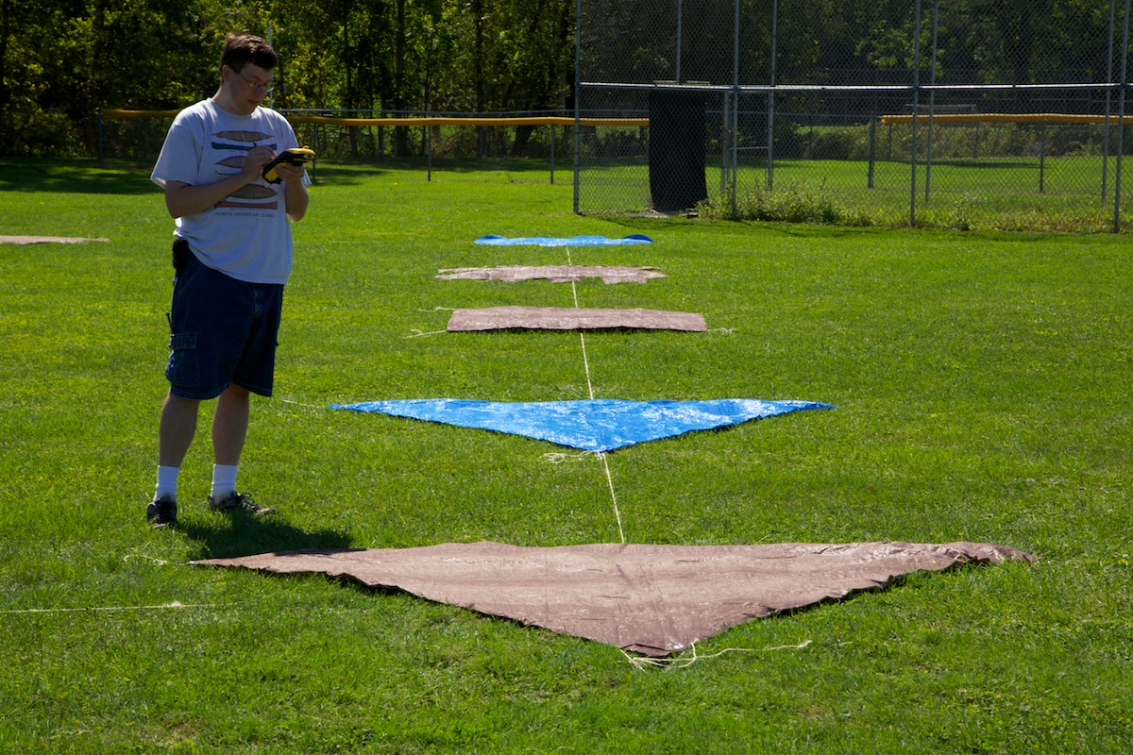
Ground Photos: 2012-09-20 PM
37
40
32
35
36
30
31
41
42
45
46
47
50
51
52
55
56
57
60
61
65
62
66
67
Name: _MG_9200.jpg
Description: Column A
Date: 2012-09-20 PM

Slide 42
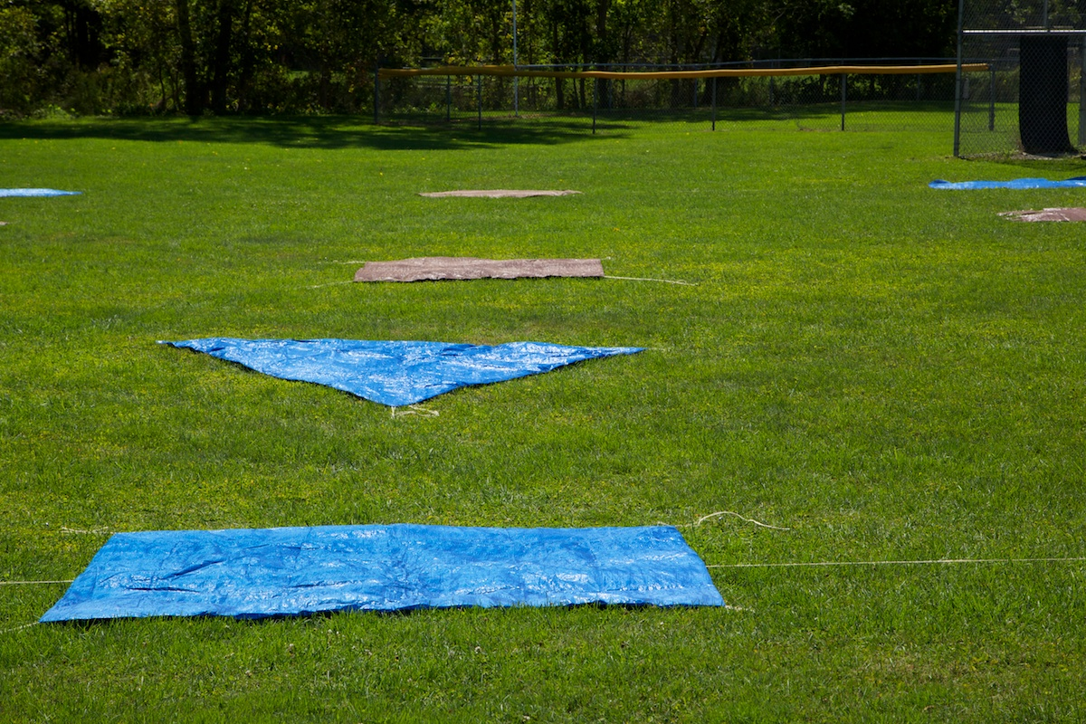
Ground Photos: 2012-09-20 PM
37
40
32
35
36
30
31
41
42
45
46
47
50
51
52
55
56
57
60
61
65
62
66
67
Name: _MG_9203.jpg
Description: Column B
Date: 2012-09-20 PM

Slide 43
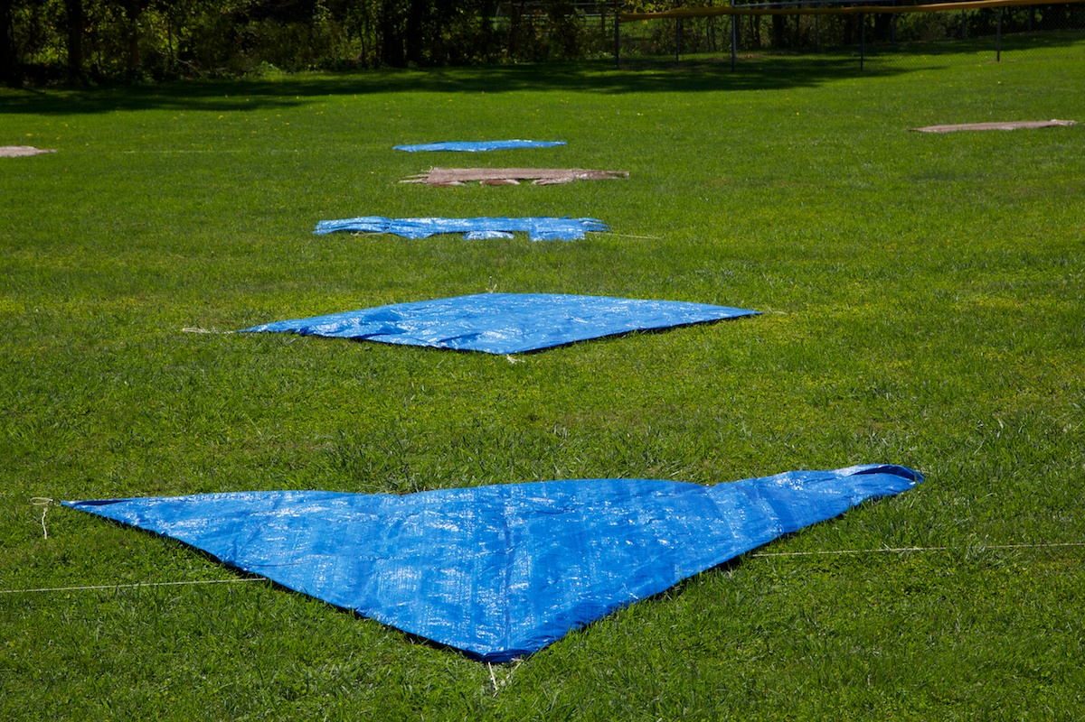
Ground Photos: 2012-09-20 PM
37
40
32
35
36
30
31
41
42
45
46
47
50
51
52
55
56
57
60
61
65
62
66
67
Name: _MG_9204.jpg
Description: Column C
Date: 2012-09-20 PM

Slide 44
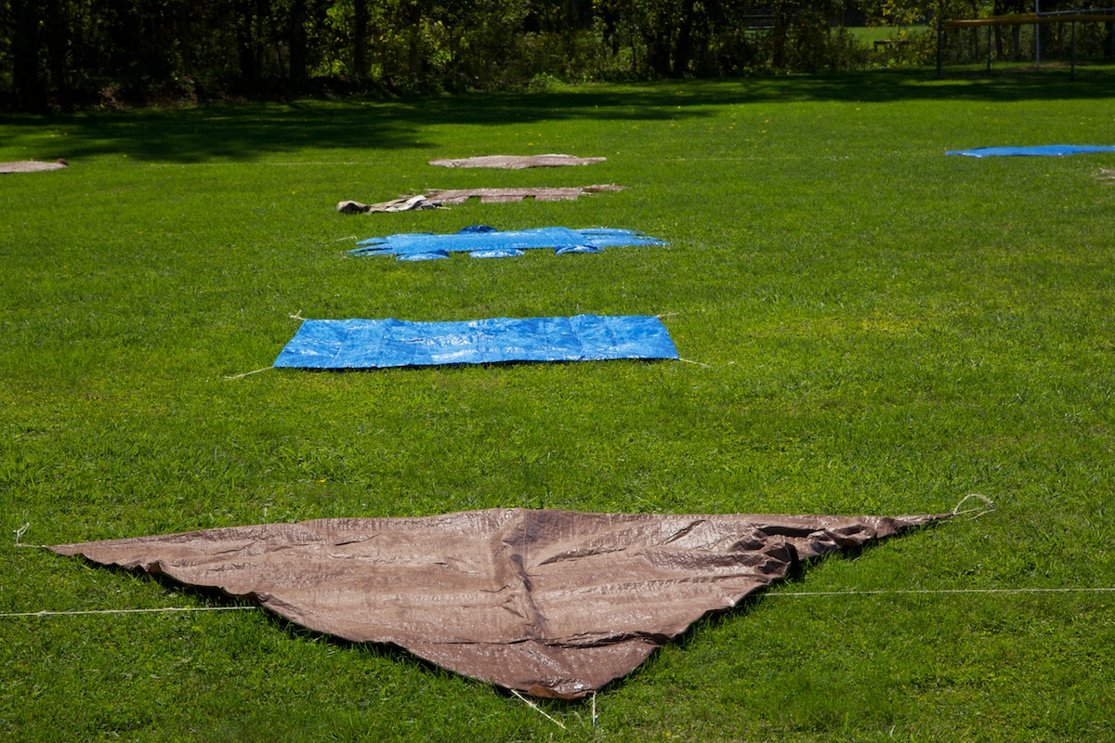
Ground Photos: 2012-09-20 PM
37
40
32
35
36
30
31
41
42
45
46
47
50
51
52
55
56
57
60
61
65
62
66
67
Name: _MG_9207.jpg
Description: Column D
Date: 2012-09-20 PM

Slide 45
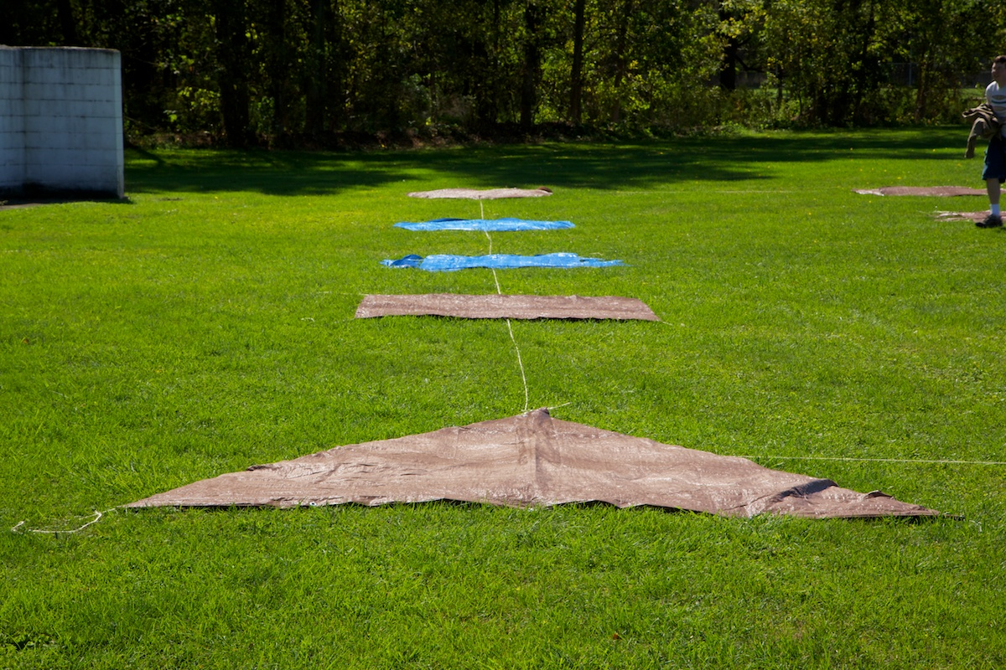
Ground Photos: 2012-09-20 PM
37
40
32
35
36
30
31
41
42
45
46
47
50
51
52
55
56
57
60
61
65
62
66
67
Name: _MG_9208.jpg
Description: Column E
Date: 2012-09-20 PM

Slide 46
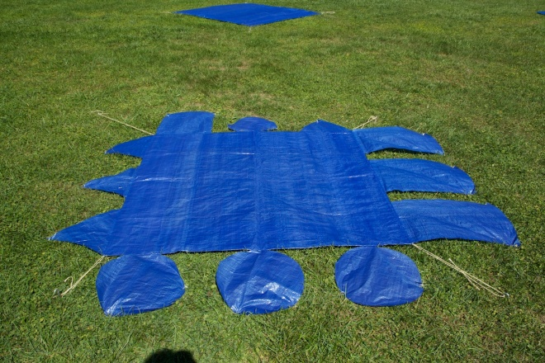
20120920 PM Asymmetric Targets (Looking North)
50 at 3C (_MG_9214.jpg)
51 at 3D
(_MG_9216.jpg)
52 at 3E
(_MG_9219.jpg)
55 at 4A
(_MG_9220.jpg)
56 at 4C
(_MG_9224.jpg)
57 at 4D
(_MG_9226.jpg)

Slide 47
Team Information
Jason Kaufman, Space Computer Corporation kaufman@spacecomputer.com
Joe Meola, AFRL/RYMT joseph.meola@wpafb.af.mil
Karmon Vongsy, AFRL/RYATX karmon.vongsy@wpafb.af.mil

