Slide 1
United Technologies Aerospace Systems Target Deployment
SHARE 2012

Slide 2
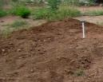
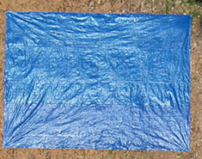
Ground Based Targets
Fertilizer from Home Depot
2 ft
10 ft
2 ft
1 ft
2 ft
Disturbed Earth Scenario
2 ft
12 ft
Blue Tarp and Fertilizer Scenario

Slide 3
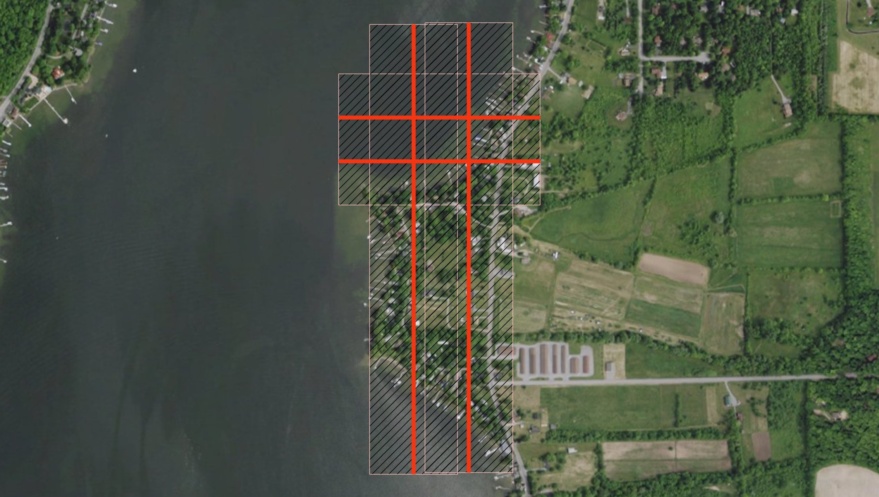
Conesus In-Water Targets
SpecTIR 2300 feet Above MSL

Slide 4
Water Based Target Grid
Targets secured and floating
on the waters surface (S)
Open water
S
S
S
S
D
D
D
D
3 18” Buoys
3 24” Concave Wire
Shells
2 Rectangular
Laundry Baskets
8 Anchors: Cement
Blocks
Targets secured and
submerged 1-2 feet (D)
Shoreline

Slide 5
Conesus Lake: Target Layout

