Slide 1
The RIT SHARE 2012 Data Collection
AnneMarie Giannandrea, Nina Raqueno, David W. Messinger, Jason Faulring, John P. Kerekes, Jan van Aardt, Kelly Canham, Shea Hagstrom, Erin Ontiveros, Aaron Gerace, Jason Kaufman, Karmon M. Vongsy, Heather Griffith, Brent D. Bartlett, Emmett Ientilucci, Joseph Meola, Lawrence Scarff, Brian Daniel
Contact:
Nina Raqueno
585-475-7676
nina@cis.rit.edu

Slide 2
Introduction
The Digital Imaging and Remote Sensing (DIRS) Lab at the Rochester Institute of Technology Collected a multi-modal data set with ground truth which is freely available at http://www.cis.rit.edu/remote-sensing/resources

Slide 3
Data Available Via Website
WASP data (Geo-TIFF)
LiDAR Data (LAS)
SpecTIR Data (ENVI)
All ground truth (Various formats)
http://www.rit.edu/cos/share2012/

Slide 4
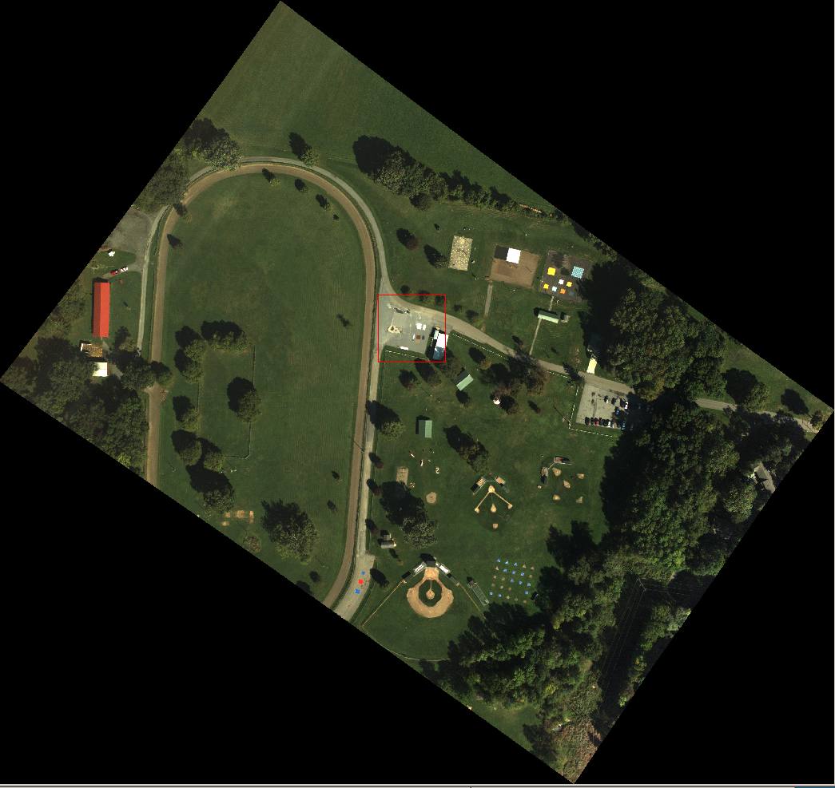
RIT’s SHARE2012
Mineral deployment
by RITRE
9/20/2012
Main Avon Park
WASP VNIR083

Slide 5
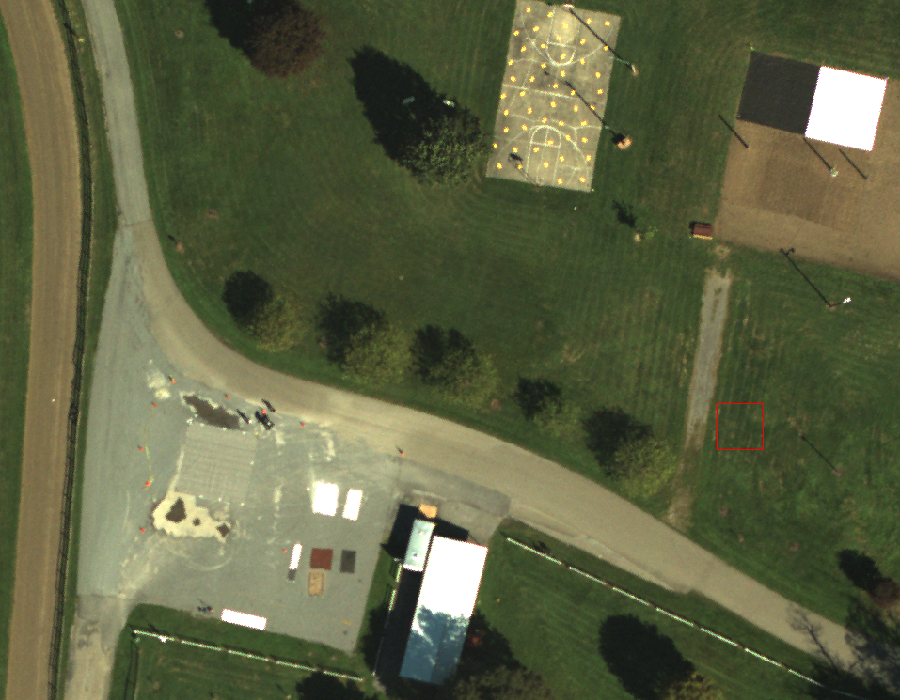
Black Felt
Cal Panel
Raked
Sand
White Tyvek
Cal Panel
Gray Canvas
Cal Panel
Montmorillonite
Kaolite
N
Gravel
Parking Lot
Calcite Hematite Magnetite
Muscovite

Slide 6
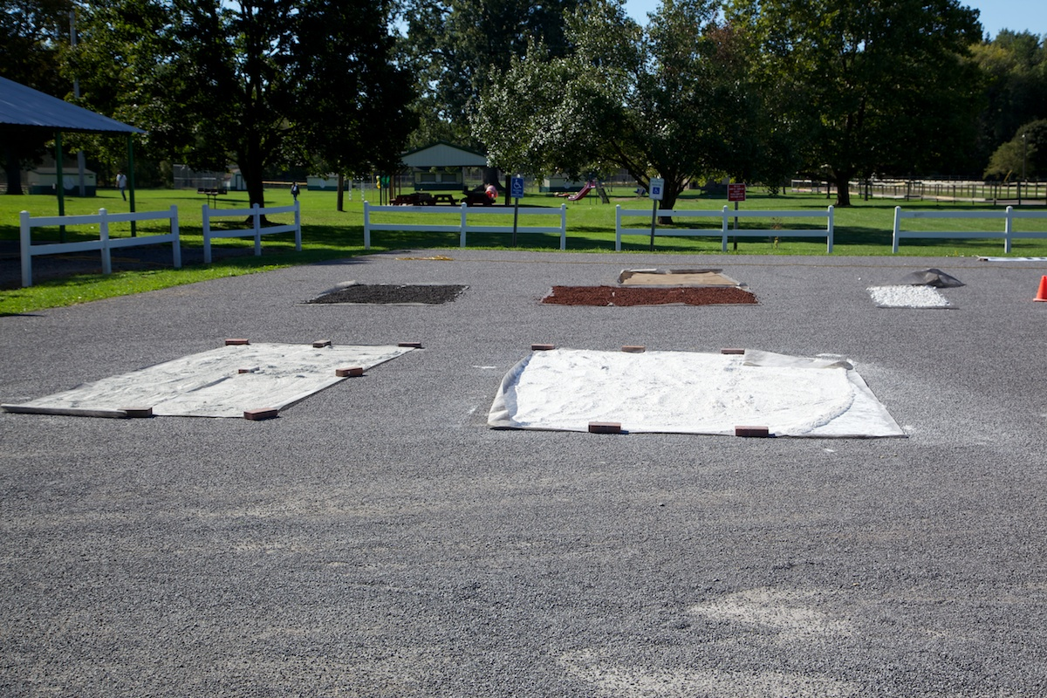
Ground Photos of Mineral Deployment
direction of
ground photo

Slide 7
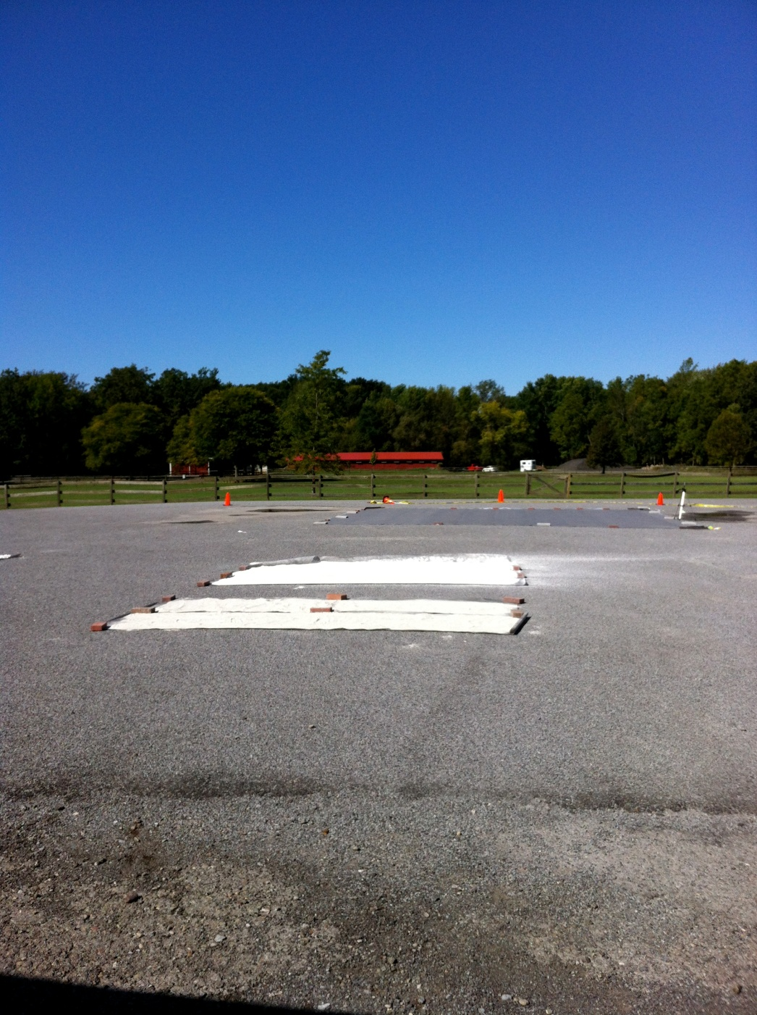
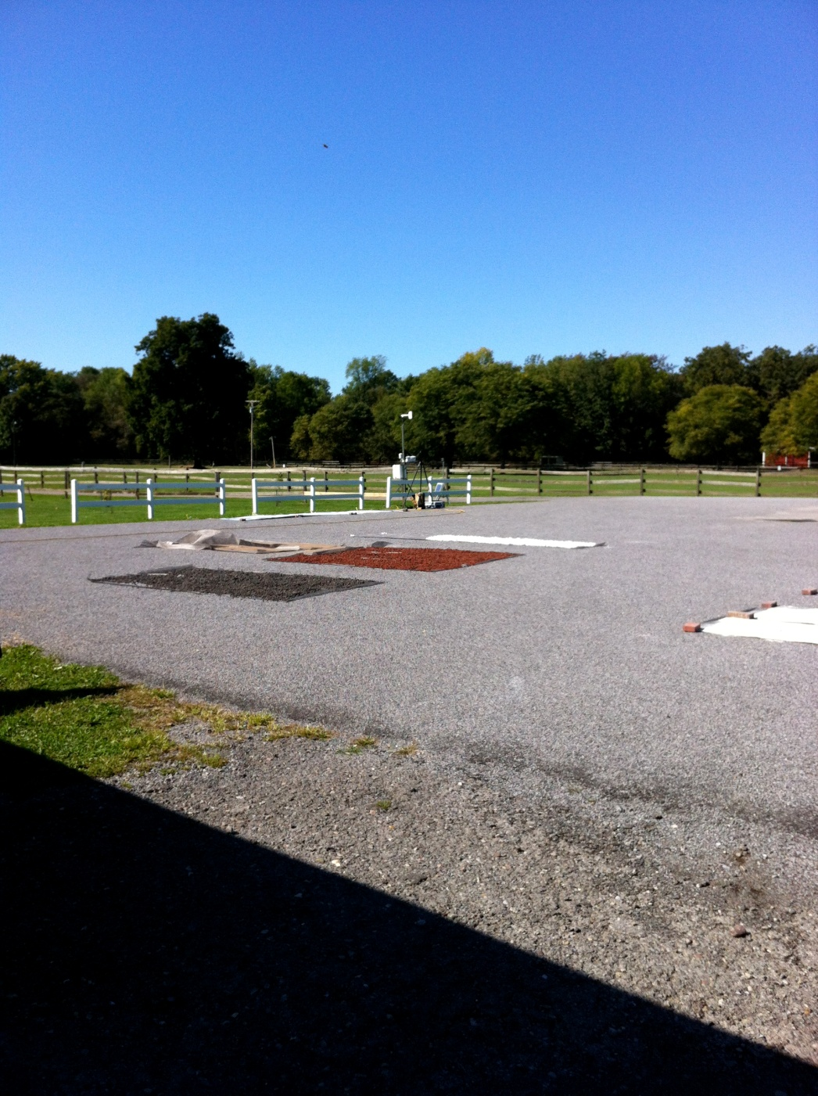
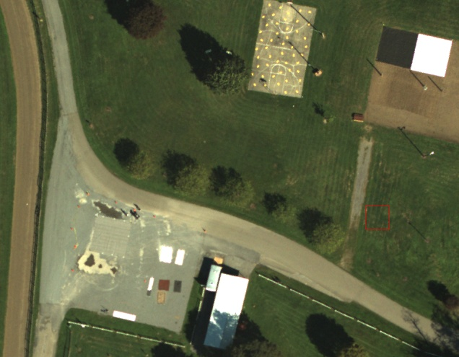
Ground Photos of Mineral Deployment
direction of
ground photos

Slide 8
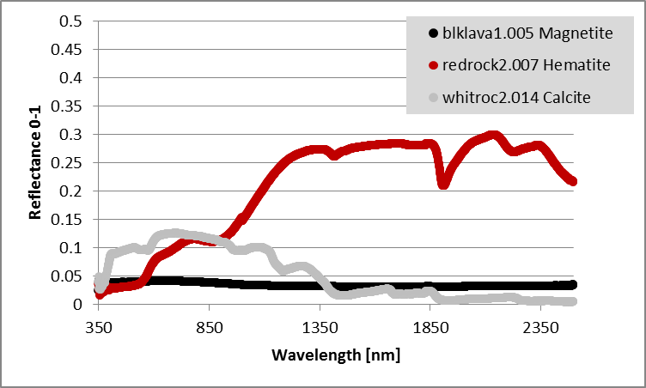
Black Felt
Cal Panel
Raked
Sand
White Tyvek
Cal Panel
Gray Canvas
Cal Panel
Montmorillonite
Kaolite
N
Gravel
Parking Lot
Calcite Hematite Magnetite
Muscovite
Example Spectra, see MineralDeploymentSpectra.zip

Slide 9
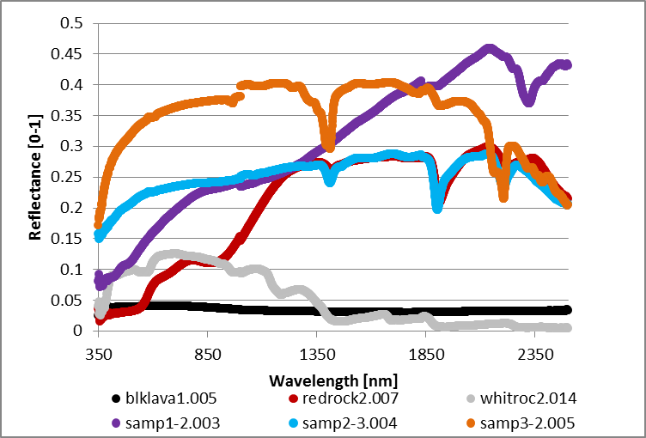
Black Felt
Cal Panel
Raked
Sand
Unknown Sample Spectra 1,2,3 were challenge spectra left for the user to identify between Montmorillonite, Kaolite, Muscovite
White Tyvek
Cal Panel
Gray Canvas
Cal Panel
Montmorillonite
Kaolite
N
Gravel
Parking Lot
Calcite Hematite Magnetite
Muscovite
Example Spectra, see MineralDeploymentSpectra.zip

Slide 10
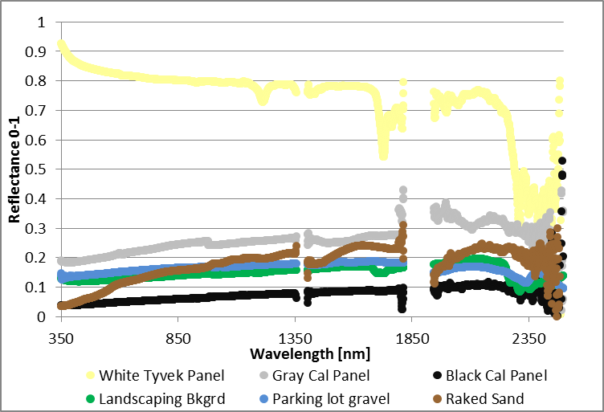
Black Felt
Cal Panel
Raked
Sand
All minerals were placed on top of a landscaping fabric as a background. Three large main calibration panels were in close proximity to minerals.Additional background spectra was collected of the volleyball court sand & gravel parking lot.
White Tyvek
Cal Panel
Gray Canvas
Cal Panel
Montmorillonite
Kaolite
N
Gravel
Parking Lot
Calcite Hematite Magnetite
Muscovite
Example Spectra, see MineralDeploymentSpectra.zip

