Slide 1
The SHARE 2012 Data Collection
AnneMarie Giannandrea, Nina Raqueno, David W. Messinger, Jason Faulring, John P. Kerekes, Jan van Aardt, Kelly Canham, Shea Hagstrom, Erin Ontiveros, Aaron Gerace, Jason Kaufman, Karmon M. Vongsy, Heather Griffith, Brent D. Bartlett, Emmett Ientilucci, Joseph Meola, Lawrence Scarff, Brian Daniel

Slide 2
Introduction
The Digital Imaging and Remote Sensing (DIRS) Lab at the Rochester Institute of Technology Collected a multi-modal data set with ground truth which is freely available at dirs.cis.rit.edu.
This dataset was collected with the aim of being as multi-modal as possible while still collecting accurate ground truth.

Slide 3
8:00 am
Begin
Target
Deployment
10:00 am
Begin
first
WASP
Flightlines
12:00 pm
Begin
Conesus
Flightlines
1:00 pm
Begin
Quarry
Flightlines
2:00 pm
Begin
MITRE
Flights
2:00 pm
Begin
Afternoon
Avon
Flightlines
7:30 am
Initial
Briefing
9:20 am
First
Radiosonde
Launch
11:45 am
Second
Radiosonde
Launch
12:30 pm
Begin
Hemlock
Flightlines
4:30 pm
End
of Day

Slide 4
Locations
Three main locations were identified:
Avon Driving Park
Conesus Lake
Hemlock Lake
As well as several sub-locations:
Silo array
Barilla Plant
Kraft Plant
Dolomite Quarry
City of Rochester (SpecTIR Only)

Slide 5
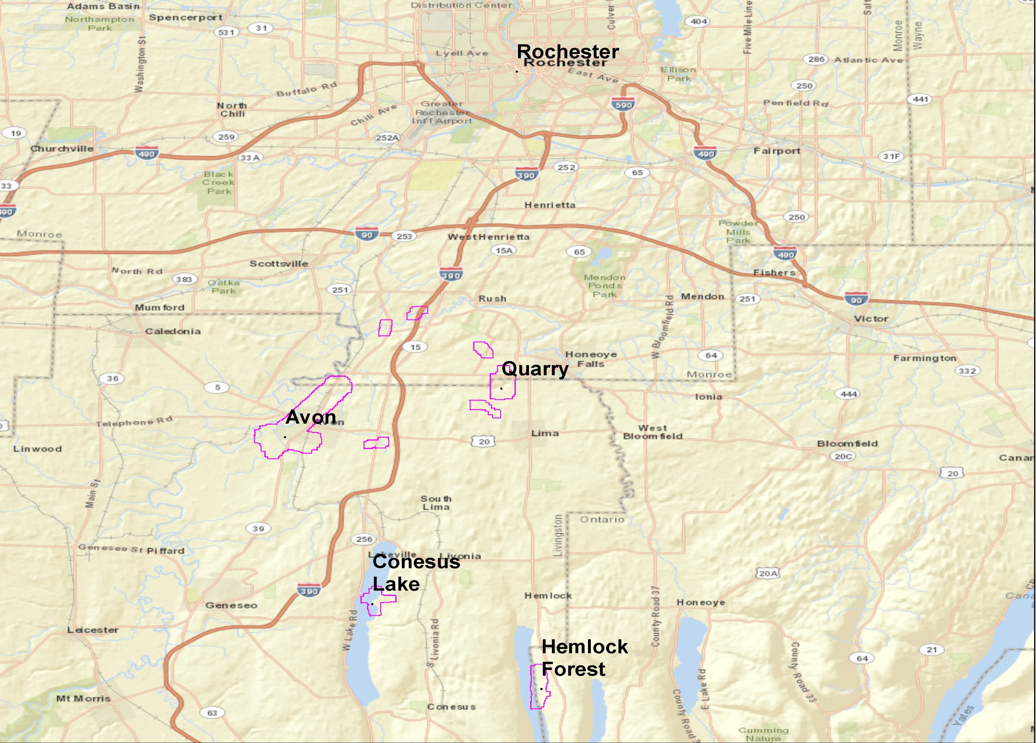
Notes:
Highlight the ROC area and then draw attention to Avon in particular. Quickly highlight Conesus and Hemlock wrt Avon. Site was selected to be outside of the KROC restricted airspace and in a functioning railroad corridor.

Slide 6
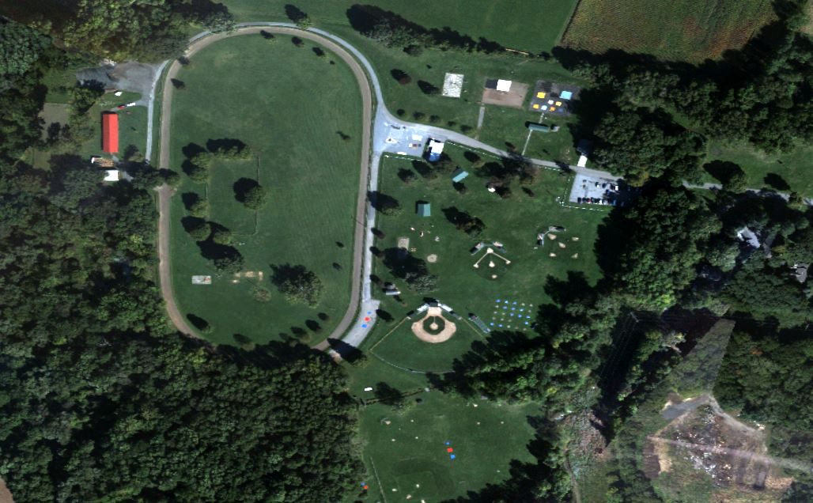
Avon, 9/20/2012
Notes:
And this is the Avon site on the day of the collect.

Slide 7
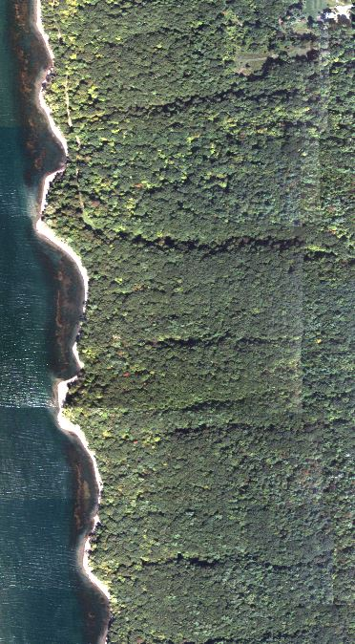
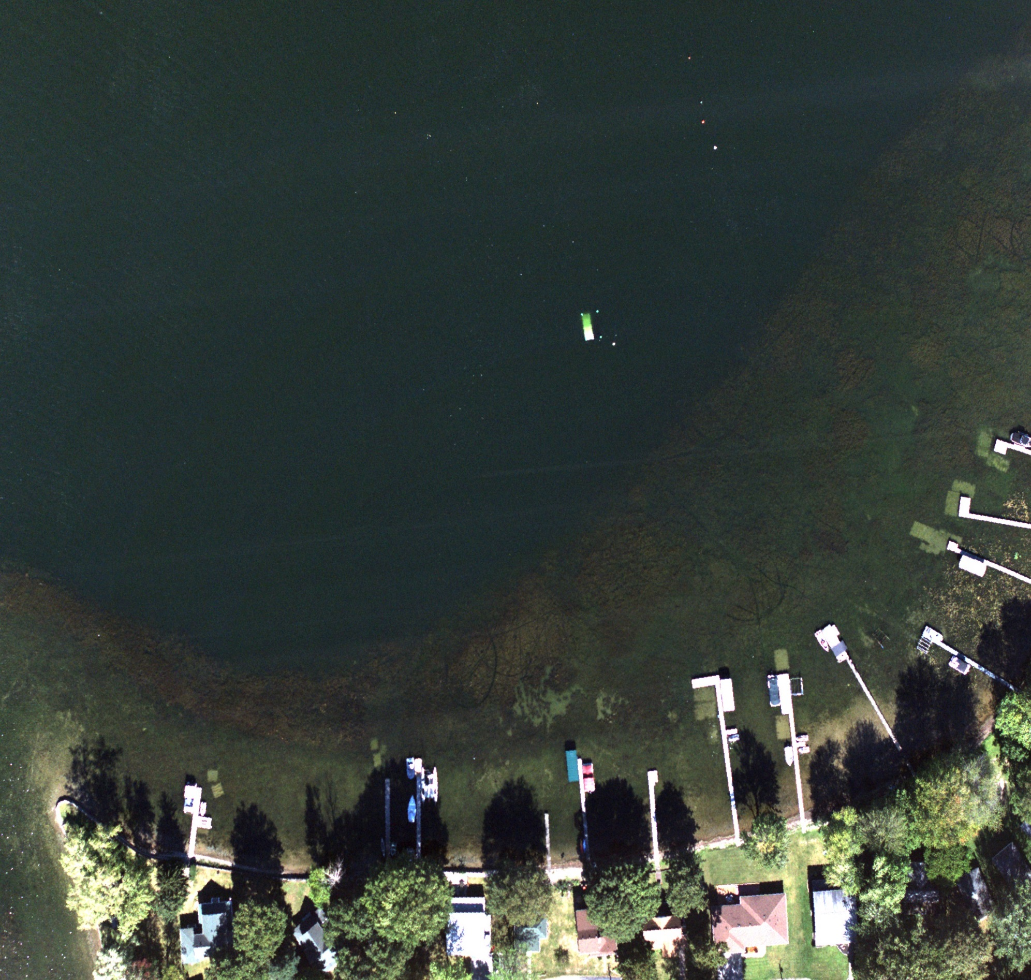
Conesus, 9/20/2012
Hemlock, 9/20/2012
Notes:
First: Conesus site. Utilised dock and off shore area for water based experiments. On Click: Hemlock. Utilised for on going forestry experiments (most GT was collected before or immediately after the experiment day.)

Slide 8
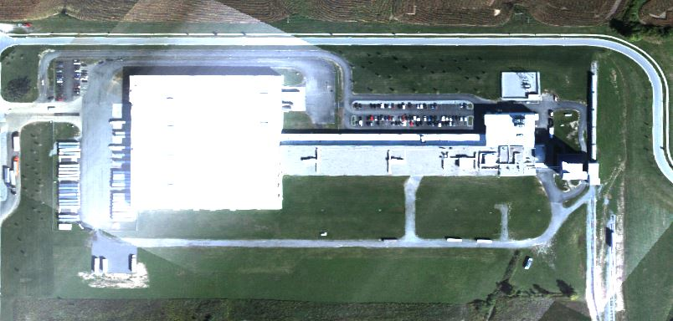
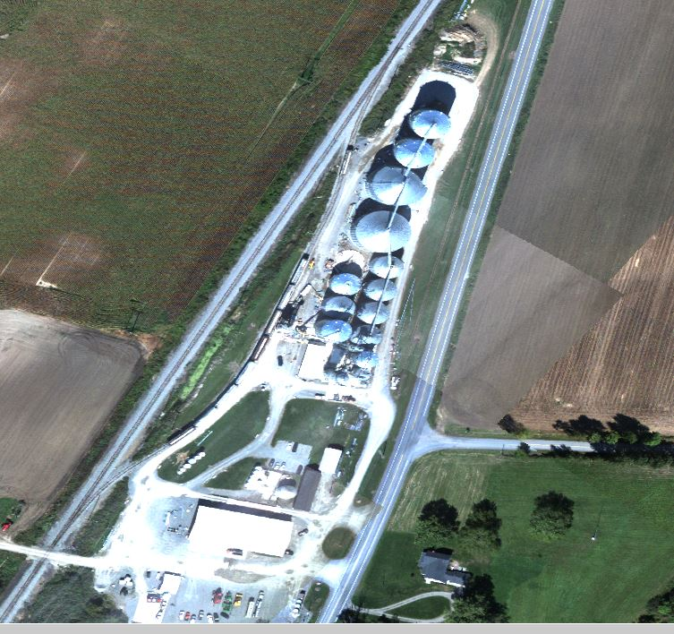
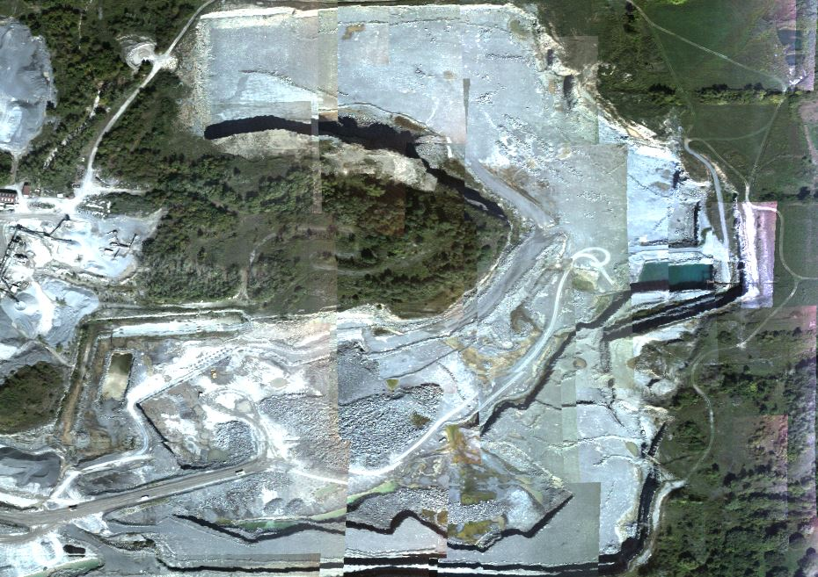
Barilla, 9/20/2012
Silos, 9/20/2012
Quarry, 9/20/2012
Notes:
Opportunity Targets:
On Slide: Barilla plant. Immediately north of the Avon GT site. Observed for the Parallax mitigation experiment. Of interested for 3D reconstruction testing.
On Click 1: Silos. Northernmost portion of the Avon Flights. A more difficult 3D reconstruction target.
On Click 2: Quarry. North of Conesus and Hemlock. Interesting shapes for 3D reconstruction, possibility for material identification and fusion studies.

Slide 9
Instrumentation
SpecTIR ProSpecTIR V2
RIT’s WASP
Leica ALS60
MITRE Experimental FMV Polarimetric Sensor
WorldView2
GeoEYE 1
HICO
Notes:
Don’t accidentally mention NRL HSI.
Spectir: 256 bands, Hyperspectral
Wasp: 6 bands, multispectral
Lidar: pulsed oscillating mirror at 1024 nm
Mitre: experimental. FMV, 24 band hyperspectral, 4 bands polarized
Worldview: 9 bands (8+ Pan) multispectral. Space Based. Commercial.
GeoEye1: 5 bands (4+ Pan) multispectral. Space based. Commercial.
HICO: 124 bands Hyperspectral. Space based. NRL

Slide 10
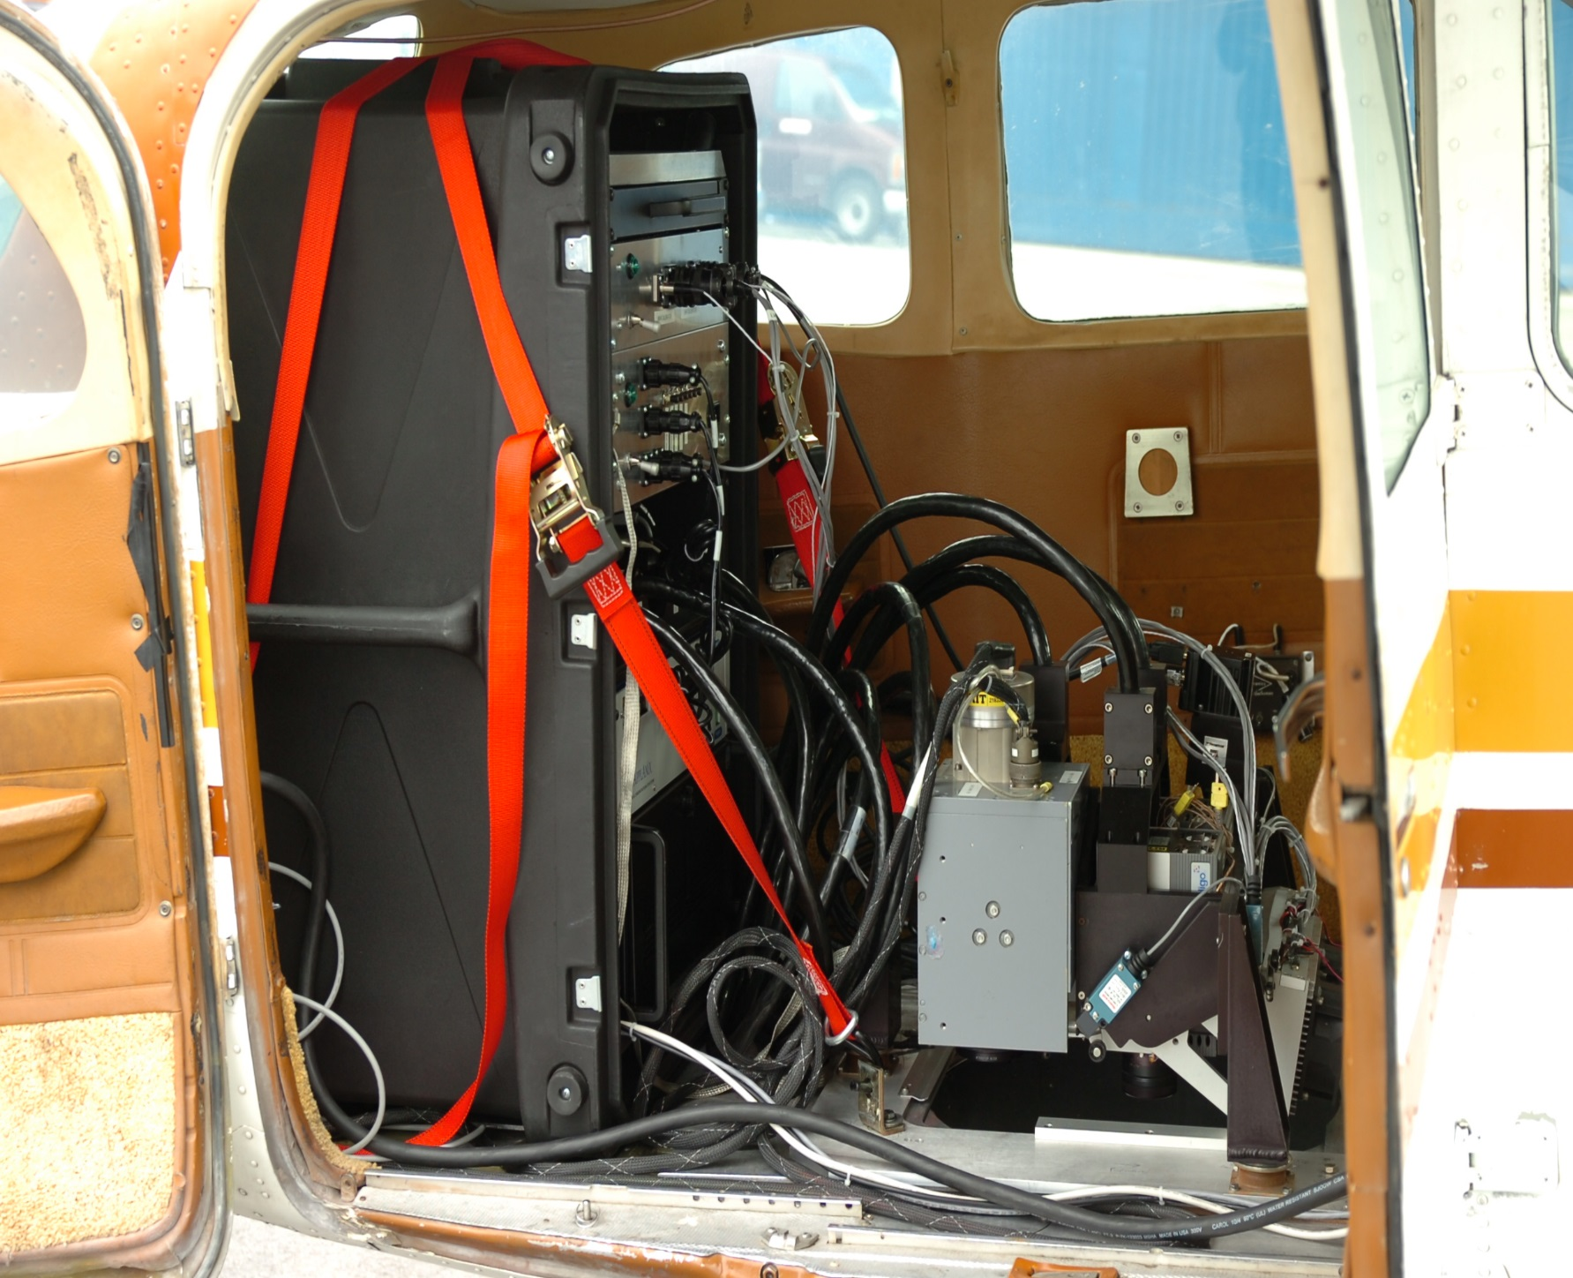
Instrumentation
WASP and LiDAR flew all the main target areas.
The MITRE sensor flew in the afternoon to capture lower solar angles only at the Avon site.
SpecTIR also captured a short flight line at the center of the City of Rochester.
Notes:
That’s a picture of WASP, the only sensor we have a picture of that I can talk about

Slide 11
Instrumentation
Sensor | GSD | Altitude (ft. AGL) | Bands | Look Angle | Polarized Bands | FOV (degrees)
WASP | 10.97 cm 60.96 cm (IR) | 2000 | 6 | 0 | 0 | 36
Leica ALS60 | 15 cm | 2000 | 1 | 0 | 0 | 20; 12 (Hemlock)
SpecTIR | 99 cm; 59 cm (Conesus) | 2500 | 256 | 0 | 0 | 24
MITRE FMV | 103 - 206 cm | 2000 &4000 | 24 | 45 (est.) | 4 | 20
WorldView2 | 50 cm (Pan); 200 cm | 2,526,200 | Pan + 8 | 9 | 0 | 16.4 Km
GeoEye1 | 50 cm (Pan); 200 cm | 2,244,094 | Pan + 4 | unknown | 0 | 15 km
HICO | 10,000 cm | 1,322,178 | 124 | unknown | 0 | 50 x 200 km

Slide 12
Ground Truth
Experiment was conducted on 9/20/2012
Ground operations ran from 7 am to 4:30 pm.
GPS and Spectral measurements were collected pre- and post- flights during the day.
Ground Based LiDAR scans were collected of buildings and trees
Two radiosondes were launched
Meteorological ground station
Notes:
Stuff we did at Avon

Slide 13
In - Scene Target Materials
Blue Felt | Gray Canvas
Blue Cotton | Camouflage Nets
Yellow Felt | Red Felt
Yellow Cotton | Blue Tarp
Pink Felt | Brown Tarp
Gold Felt | Montmorillonite
Green Felt | Kaolite
Newsprint | Magnetite
Black Felt | Calcite
White Tyvek | Muscovite
Gray Tarp | Hematite
Notes:
Most of the target materials. Must not mention the Cardboard boxes. Minerals were RITRE

Slide 14
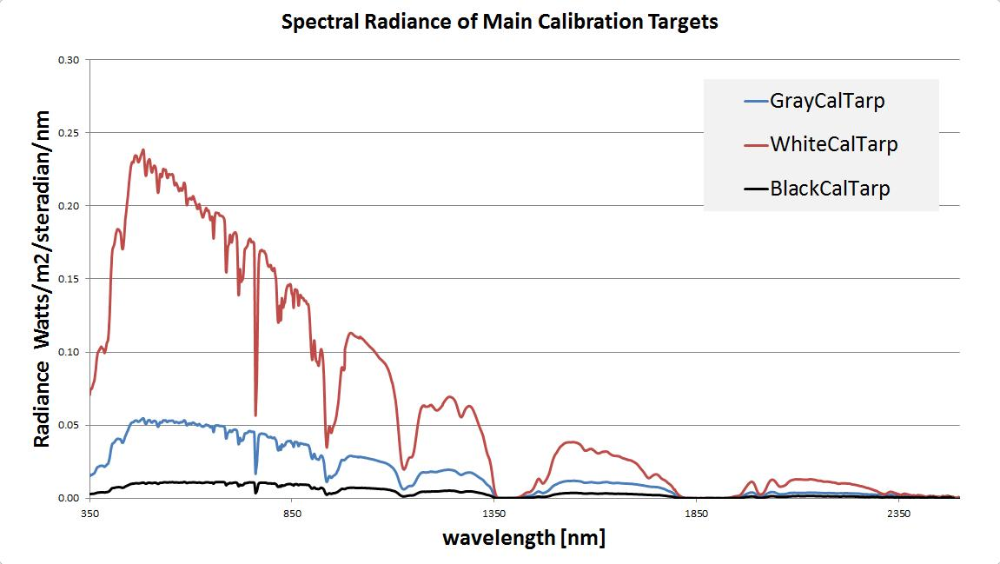
Notes:
Radiance plots for the 3 calibration targets. White is Red, gray is blue, blck is black. All look similar, with most changes in intensity. White was Tyvek; gray, canvas; black, felt.

Slide 15
Cross Calibration

Slide 16
Cross Calibration

Slide 17
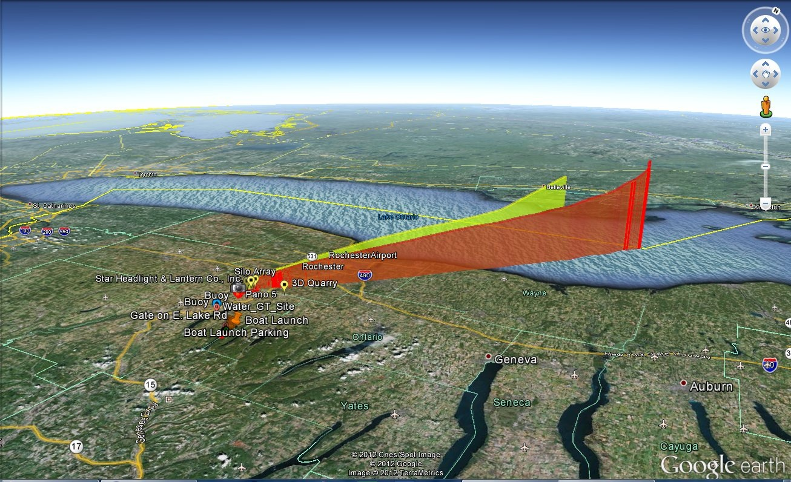
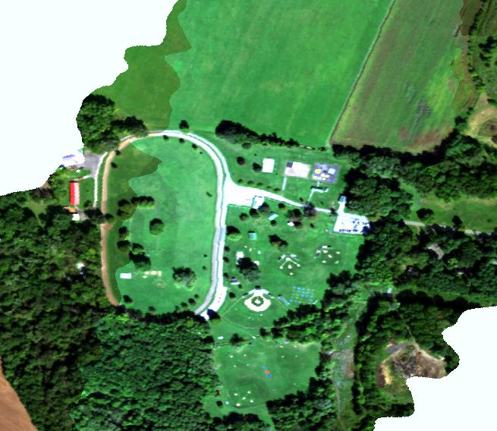
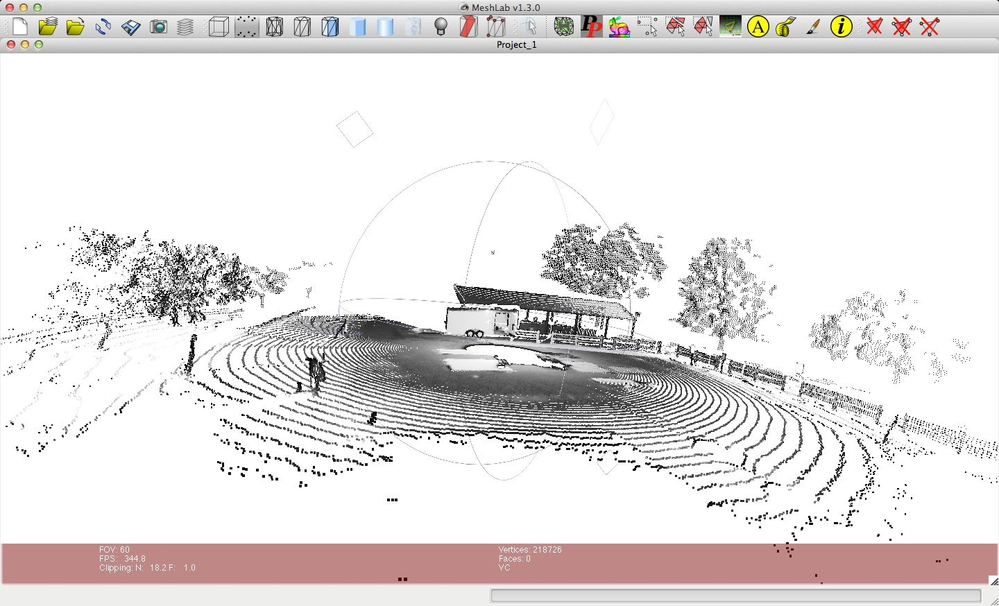
Radiosonde, 9/20/2012
SpecTIR - Avon, 9/20/2012
GBL - Avon, 9/20/2012
Notes:
Ground Truth & example of HIS data
On Slide: Spectir RGB section from day of experiment.
On Click 1: Radiosonde tracks
On Click 2: Sample GBL point cloud

Slide 18
Experiments
Experiments included:
Sub-pixel Target Detection
Spatial-Spectral Target Detection
Material Identification
Spectral Unmixing
In-Water Target Detection
Parallax Mitigation
Atmospheric Compensation
LIDAR Point Cloud Change Detection
Forest Canopy Studies
Search and Rescue
Target Detection Under Varying Illumination Conditions
Notes:
Don’t mention fusion or blind test target.

Slide 19
Data and documentation is available at dirs.cis.rit.edu/resources
Notes:
If site is up and there is internet in the room, this may be a demo. If not, may redirect to sample site, or leave as link.

Slide 20
Data Available Via Website
WASP data (Geo-TIFF)
LiDAR Data (LAS)
SpecTIR Data (ENVI)
All ground truth (Various formats)

Slide 21
Funding for this project was provided by the Digital Imaging and Remote Sensing Laboratory (DIRS), Exelis VIS, and United Technologies Aerospace Systems (UTAS). The authors would like to thank Exelis, NRL, UTAS, AFRL, MITRE, and RITRE for their involvement in this project. They would also like to thank SUNY Brockport for the use of their meteorological equipment.
Notes:
Acknowledgements

Slide 22
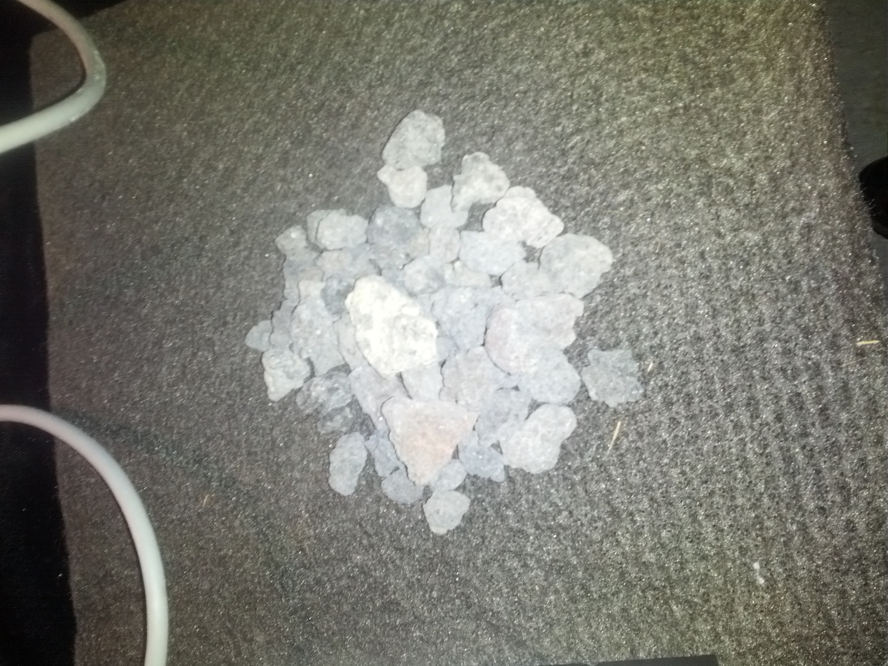
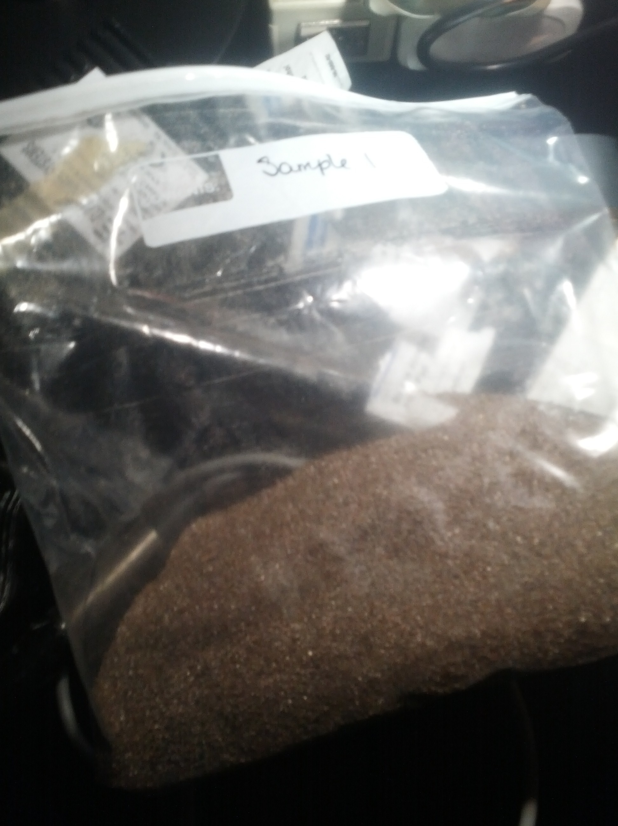
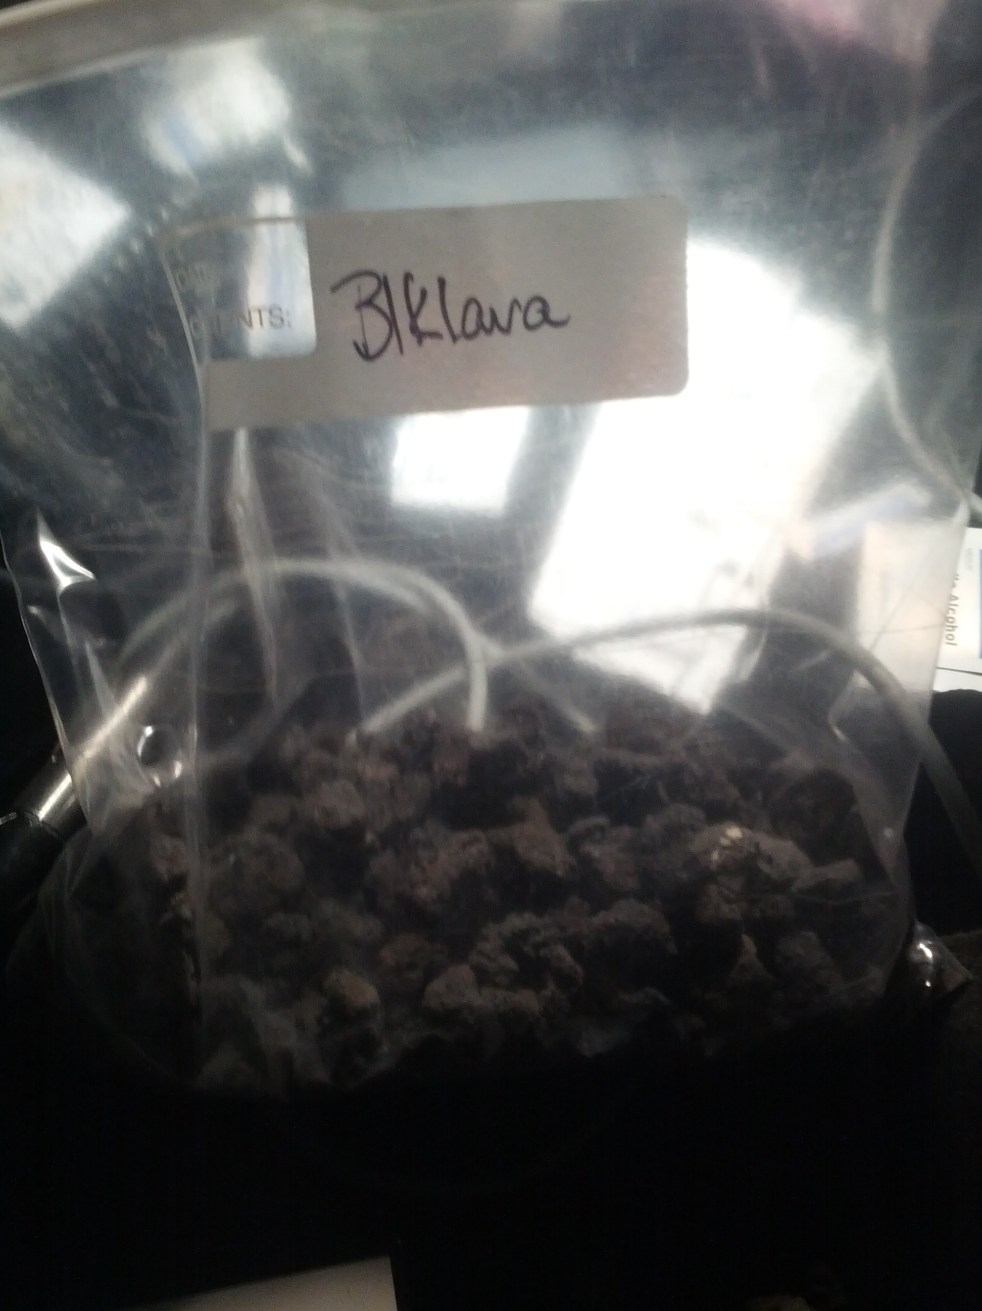
Notes:
More GT pictures, of lab samples

Slide 23
References
1. N. Raqueno, L. Smith, D. Messinger, C. Salvaggio, R. Raqueno, and J. Schott, “Megacollect 2004: Hyperspectral collection experiment of terrestrial targets and backgrounds of the RIT megascene and surrounding area (Rochester, new York)," Algorithms and Technologies for Multispectral, Hyperspectral, and Ultraspectral Imagery XI 5806, pp. 554-565, 2005.
2. R. Raqueno, N. Raqueno, A. Weidemann, S. Eer, M. Perkins, A. Vodacek, J. Schott, W. Philpot, and M. Kim, "Megacollect 2004: Hyperspectral collection experiment over the waters of the Rochester embayment,“ Algorithms and Technologies for Multispectral, Hyperspectral, and Ultraspectral Imagery XI 5806, pp. 566-577, 2005.
3. J. A. Herweg, J. P. Kerekes, O. Weatherbee, D. Messinger, J. van Aardt, E. Ientilucci, Z. Ninkov, J. Faulring, N. Raqueno, and J. Meola, "Spectir hyperspectral airborne Rochester experiment data collection campaign,“ Algorithms and Technologies for Multispectral, Hyperspectral, and Ultraspectral Imagery XVIII 8390, pp. 554-565, 2012.
4. D. Snyder, J. K. I. Fairweather, R. C. J. Shive, and S. Hager, "Development of a web-based application to evaluate target finding algorithms," 2008.
5. SpecTIR, LLC, "SpecTIR Project Report, Rochester Institute of Technology," Project Report, September 2012.
6. M. Casterline, C. Salvaggio, A. Garrett, J. Faulring, B. Bartlett, and P. Salvaggio, "Improved temperature retrieval methods for the validation of a hydrodynamic simulation of a partially frozen power plant cooling lake," in Proceedings of SPIE, SPIE Defense and Security, Thermosense XXXII, Utilities and Fluid Dynamics, (Orlando, Florida, United States), April 2010.
7. J. van Aardt, D. McKeown, J. Faulring, N. Raqueno, M. Casterline, C. Renschler, R. Eguchi, D. Messinger, R. Krzaczek, S. Cavillia, J. Antalovich, N. Philips, B. Bartlett, C. Salvaggio, E. Ontiveros, and S. Gill, "Geospatial disaster response during the Haiti earthquake: A case study spanning airborne deployment, data collection, transfer, processing, and dissemination," Photogrammetric Engineering and Remote Sensing 77(9), pp. 943-952, 2011.
8. Kucera International Inc., "Lidar Services." Web, 2011. Feb. 4, 2013.
9. J. P. Kerekes, K. Ludgate, A. Giannandrea, N. Raqueno, and D. S. Goldberg, "Share 2012: Subpixel detection and unmixing experiments," Proc. SPIE Algorithms and Technologies for Multispectral, Hyperspectral, and Ultraspectral Imagery XIX 8743, April, 2013.
10. K. Canham, D. S. Goldberg, J. P. Kerekes, N. Raqueno, and D. W. Messinger, "Share 2012: large edge targets for hyperspectral imaging applications," Proc. SPIE Algorithms and Technologies for Multispectral, Hyperspectral, and Ultraspectral Imagery XIX 8743, April, 2013.
11. E. Ientilucci, "Share 2012: analysis of illumination differences on targets in hyperspectral imagery," Proc. SPIE Algorithms and Technologies for Multispectral, Hyperspectral, and Ultraspectral Imagery XIX 8743, April, 2013.
12. D. V. der Zande, W. Hoet, I. Jonckheere, J. van Aardt, and P. Coppin, "Influence of measurement set-up of ground-based lidar for derivation of tree structure," Agricultural and Forest Meteorology 141, pp. 147-160, 2006.
13. Analytical Spectral Devices, Inc., "FieldSpec Pro User's Guide." Web, 2002. Feb. 4, 2013.
14. SpectraVista Corporation, "SVC HR-1024." Web, 2002. Feb. 4, 2013.
Notes:
References, in case someone want to see them.

Slide 24
Questions?
Thank you.
Notes:
Alternate questions slide.

